Slide 1

Wheelhouse inspection

Slide 2
Scope
What to check / look for in the wheelhouse
Data capture requirements
Catch Composition
Fishroom preps
Yellow Section of Crib

Slide 3
Aims of Wheelhouse Inspection
Check key legislative items
  Documentation (CoR, Stowage Plan etc)
Collect and record supporting data
  Master and Ownership details
  Vessel details
Interrogate logbook
  Completed in line with legislation?
Check catch composition
Prep for fish room inspection
Yellow Section of Crib

Slide 4
First Actions
Introduce yourself and show your warrant
Explain what the inspection will entail
“Master…please can you bring your logbook up to date to reflect all the species you have retained”

Slide 5
Data Capture Requirements
Crib 6
Outlines all the data you will capture during the boarding
All required to be input into MCSS to record the inspection
For the wheelhouse element, the focus is on sections A to H
Note the split between BO and ABO

Slide 6
Data Capture Requirements
MEO responsible for content
Must be entered legibly in notebook
Must be accurate – Master/Owner name, address, DOB and Place of Birth
Required for data input to MCSS
  You only get one chance at collecting this data!

Slide 7
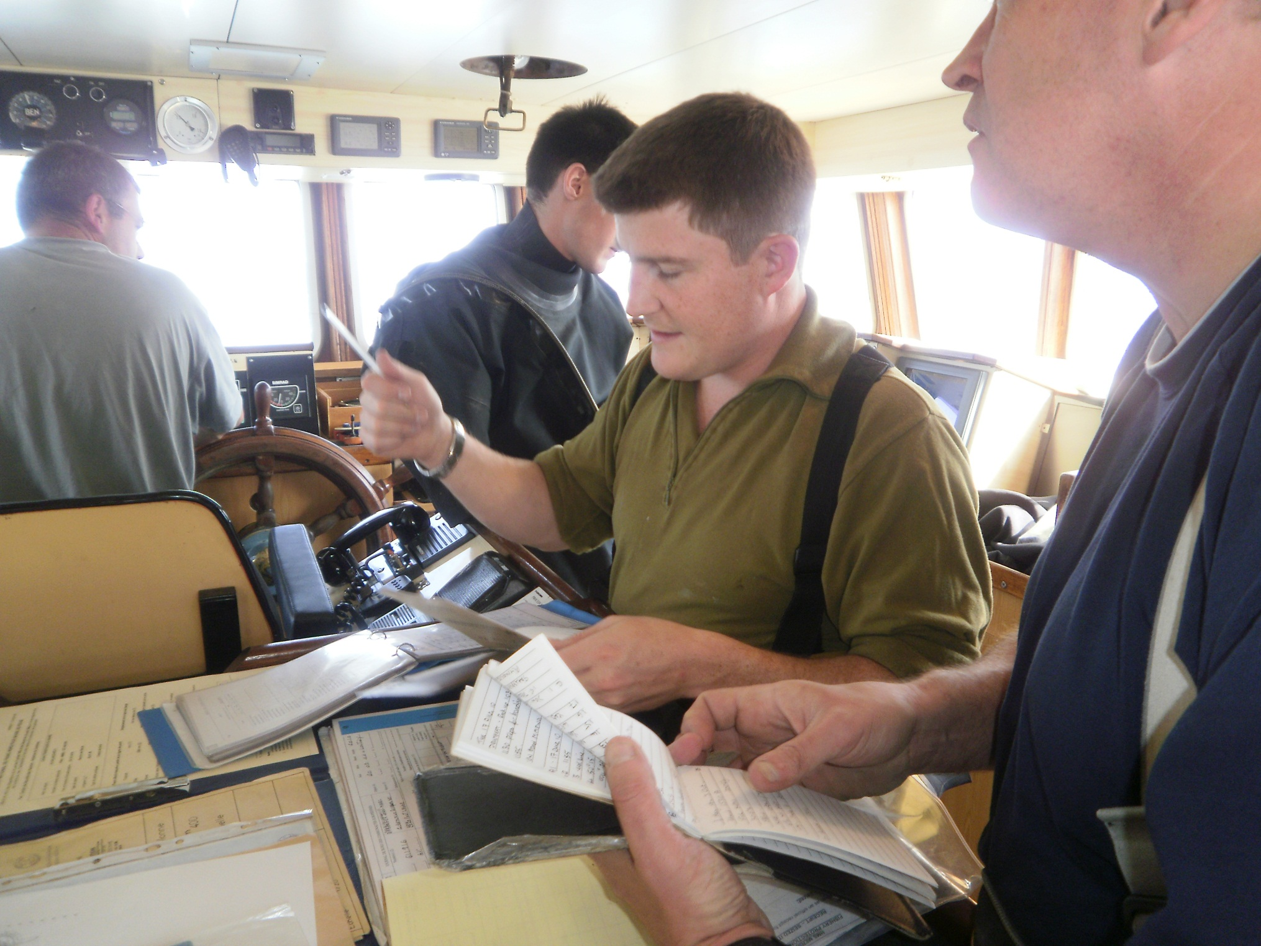

Slide 8
Legislated Items (ABO)
Fishing Licence (inc days at sea permits where appropriate) – Non UK only (UK vessels no longer need to carry on board)
Certificate of Registry (10m+ UK vessels only)
Stowage Plan if applicable
Fishroom Plan
Ullage Tables (17m+)
VMS (12m+)
AIS (15m+)
NB: Paper Logbook (10m-12m), E-log (over 12m)
Notes:
8
23 - Wheelhouse inspection

Slide 9
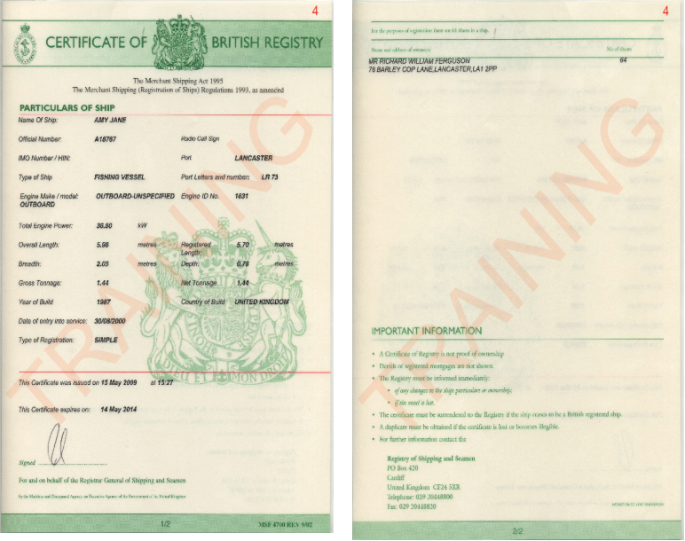
Certificate of Registry (UK)
Make a note of the expiry date

Slide 10
Stowage Plan
Required where species have been retained that are subject to multiannual plans. Must be stowed separately
Stowage Plan shows their location in the fishroom
Not certified. Probably hand drawn.
Vessels of >12m
Crib 9
 | IV | VIIa | VIId | VIIe | VIIf-j
COD | Y | Y | Y | N | N
PLE | Y | N | N | N | N
SOL | Y | N | N | Y | N
HKE | Y | Y | Y | Y | Y

Slide 11
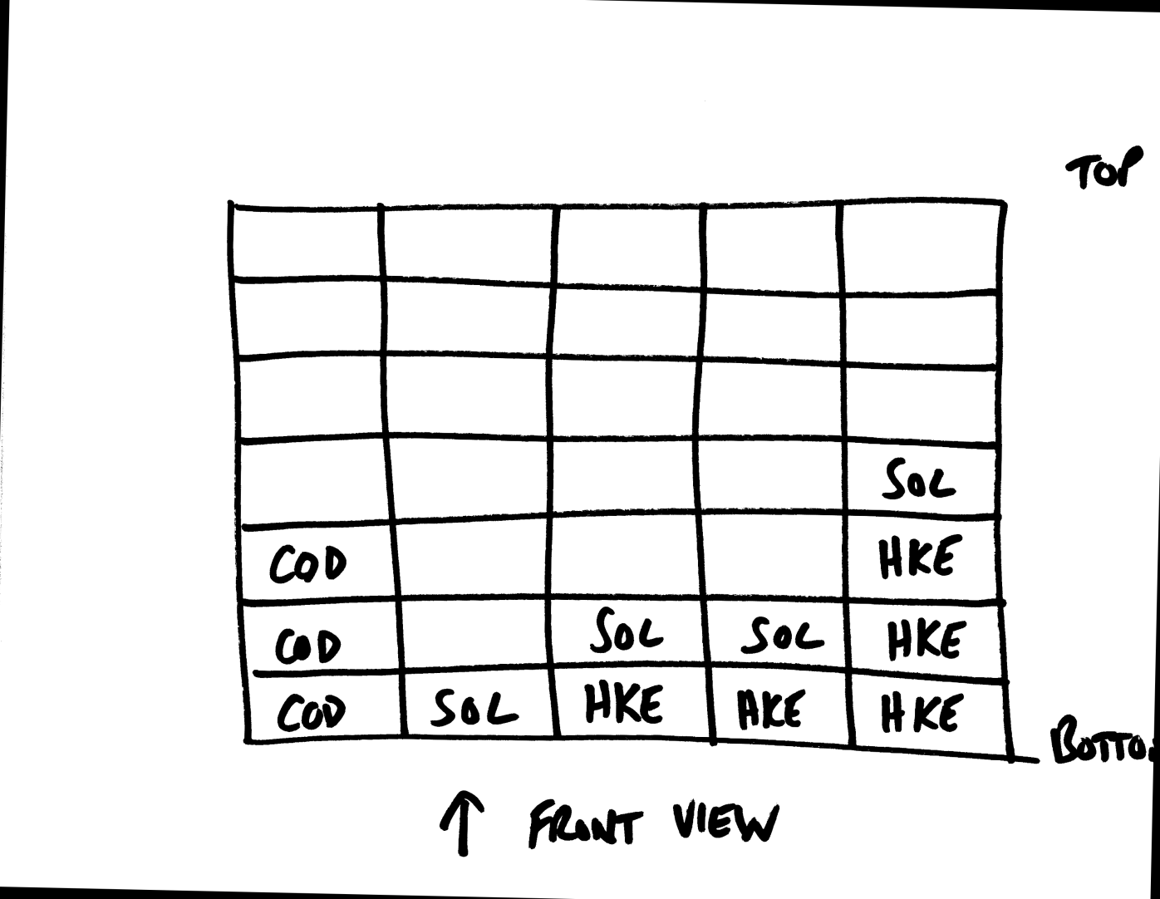
Stowage Plan – Example

Slide 12
Fishroom Plan
Fishing vessels 17 metres+ shall keep on board accurate drawings with description of its fish rooms:
Showing all access points, and storage capacity in cubic metres
Plan to be certified by the competent authority of the flag Member State
Can not be hand drawn or uncertified
Must be updated if any modifications are made

Slide 13
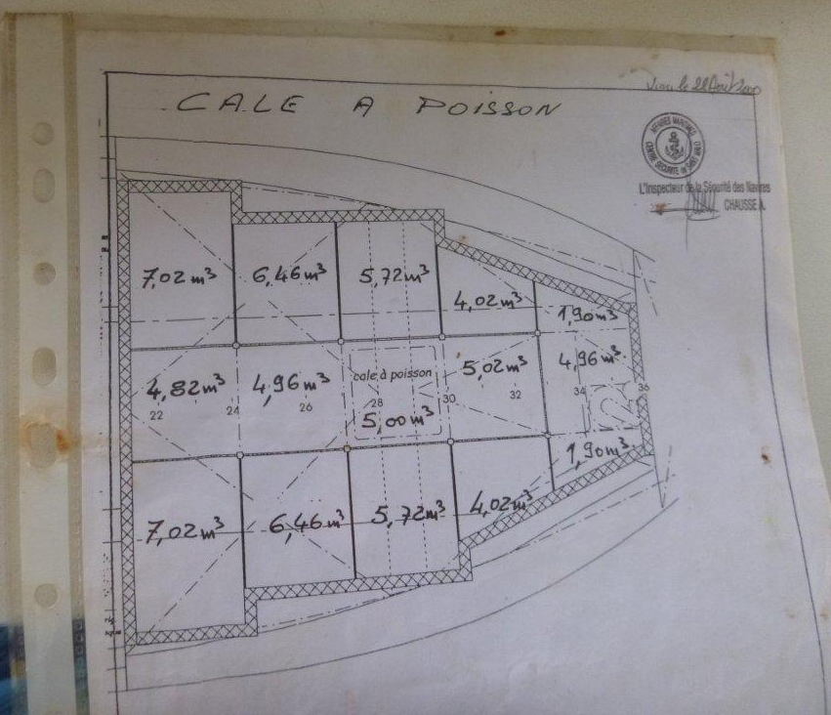
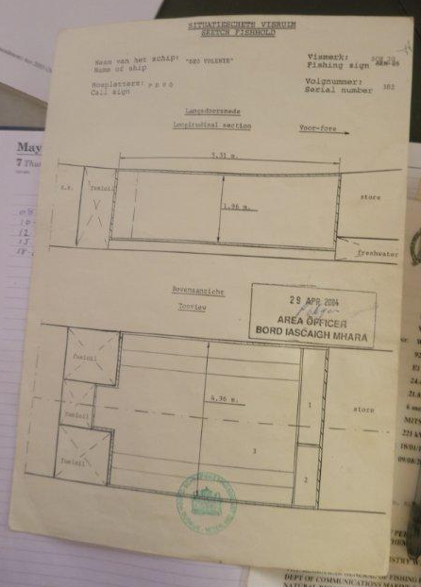
Fishroom Plans (17m+)

Slide 14
Ullage Tables for RSW Tanks
All vessels with chilled or refrigerated sea water tanks shall keep on-board a document indicating the calibration of the tanks in cubic metres at 10 cm intervals
Shall be certified by the competent authority of the flag Member State
MEO measures the displacement using a dip tape to work out remaining volume using the Ullage tables

Slide 15
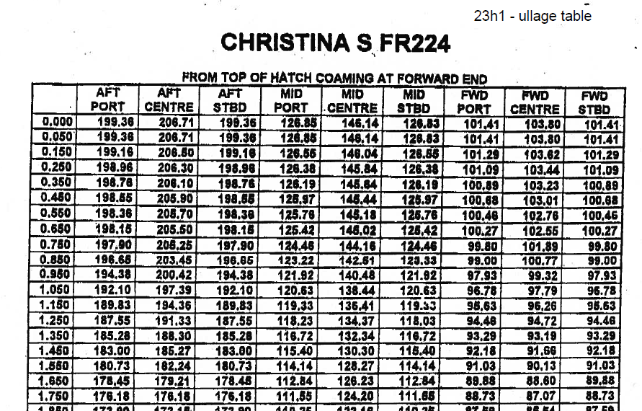
Ullage Table

Slide 16
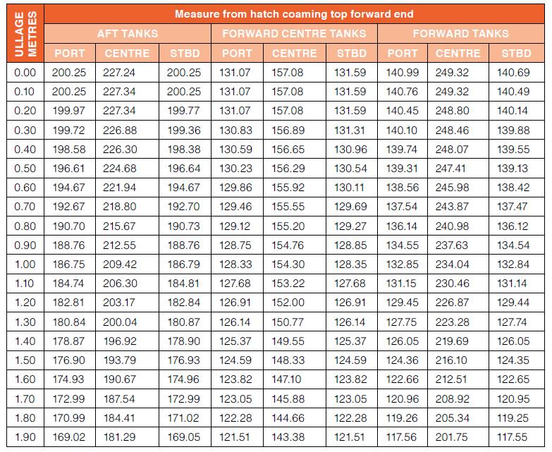

Slide 17
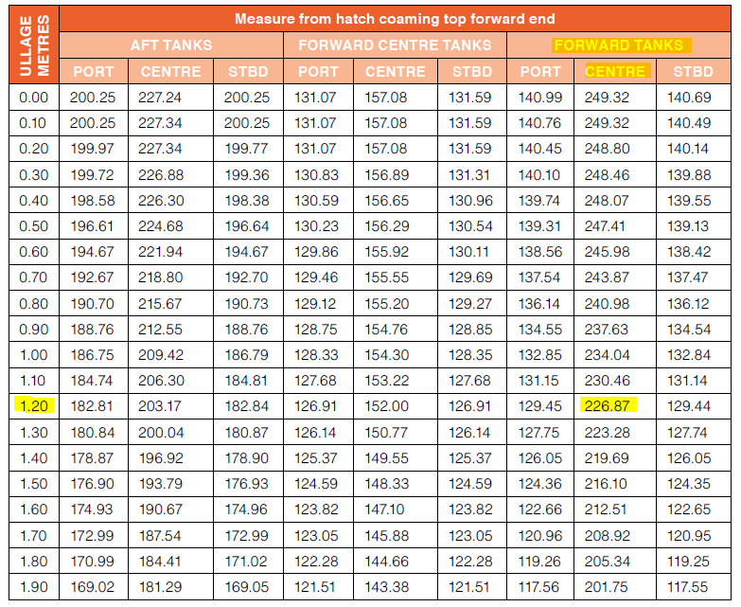
Using the dip tape, you measure from the top of the hatch, the space is 1.2 metres, therefore there is 226.87m³ of fish in the tank (you can then convert this to KG using a standardised conversion factor)

Slide 18
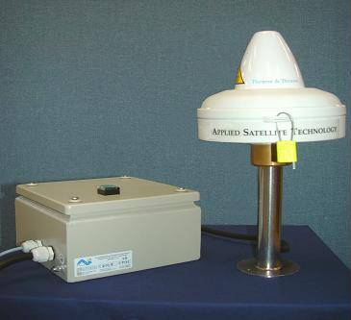
VMS Terminal (12m+)
Confirm the terminal is operational and tamper free

Slide 19
Checking the logbook
Crib 7
Completed in accordance with legislation*
Submission of FARs
Submission of EOF & RTP (landing inspection)
No erroneous/strange entries
Have undersized landing obligated species have been recorded separately?
Discards recorded?
All gear on board/different mesh sizes recorded?
*Check again on board to verify pre inspection check if applicable

Slide 20
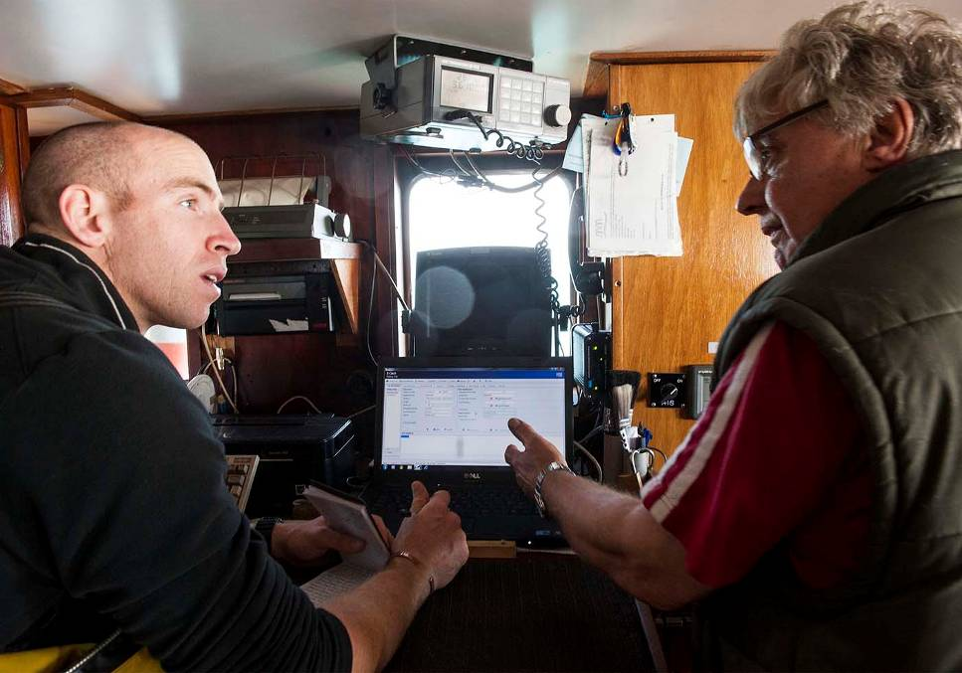
Logbook Catch Data
Must be in live weight
Anything over 50 kg retained on board
Including:
Part boxes
Vivier tanks
Any chutes to fish room

Slide 21
Documents inspected, now what?
Turn attention to catch recorded (BO)
Record data from logbook into BO notebook to:
prepare for fish room / landed catch inspection
Have information ready for check weighing
Calculate any relevant catch composition requirements based on logbook values
  e.g. checking the 20% Cod, Haddock and Saithe combined weight – What gear will you be expecting to see?

Slide 22
Prep for the fishroom inspection
Establish storage method of species
  If boxed, ask the average weight / box
  Ask how many boxes of each species
Decide which species to weigh and how many boxes (high risk?)
  At least 10% check weigh, priority is recovery species
Note/sketch the fishroom layout / dimensions in notebook
If paper logbook, remove and place in waterproof ‘mail bag’- keep with you

Slide 23
Infringements
Any infringements at this stage – take full notes in your notebook
Consider evidence you can collect
Record any significant statements
Report back to SMO/PMO if possible – notebook interview may be appropriate?
Take photographs if possible

Slide 24
Summary
Master to update logbook with everything retained
Collect info as per Crib 6 including
  ABO to check key documents
  BO to scrutinise logbook
    Calculate and check any catch composition regulations
    Consider approach to fishroom inspection
    Keep full notes, including recording logbook data
    Obtain fishroom/stowage plan if present

