Slide 1
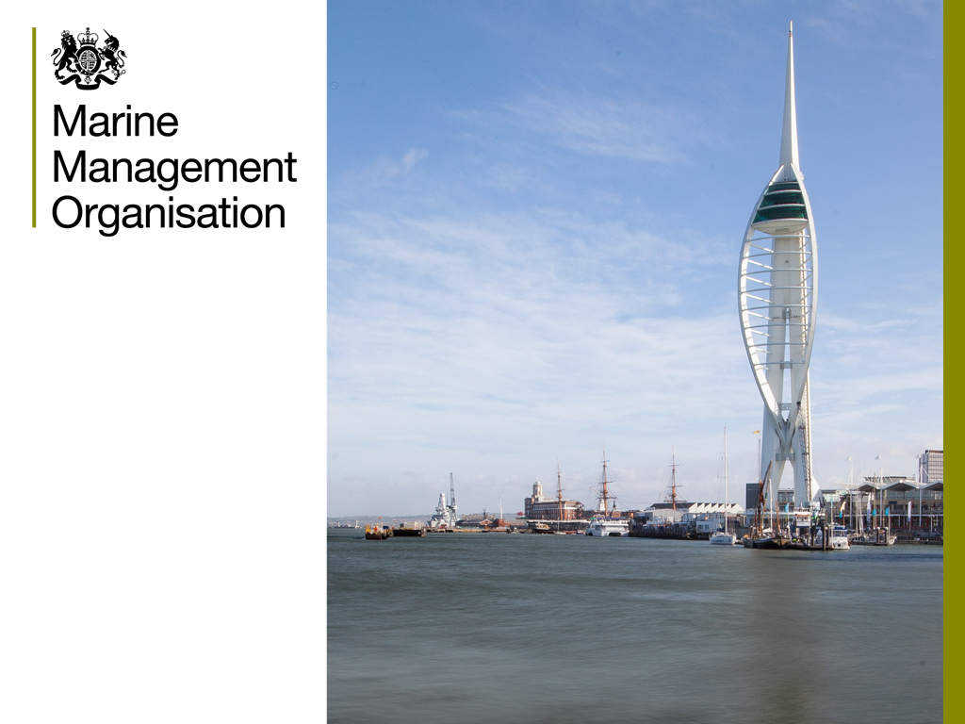
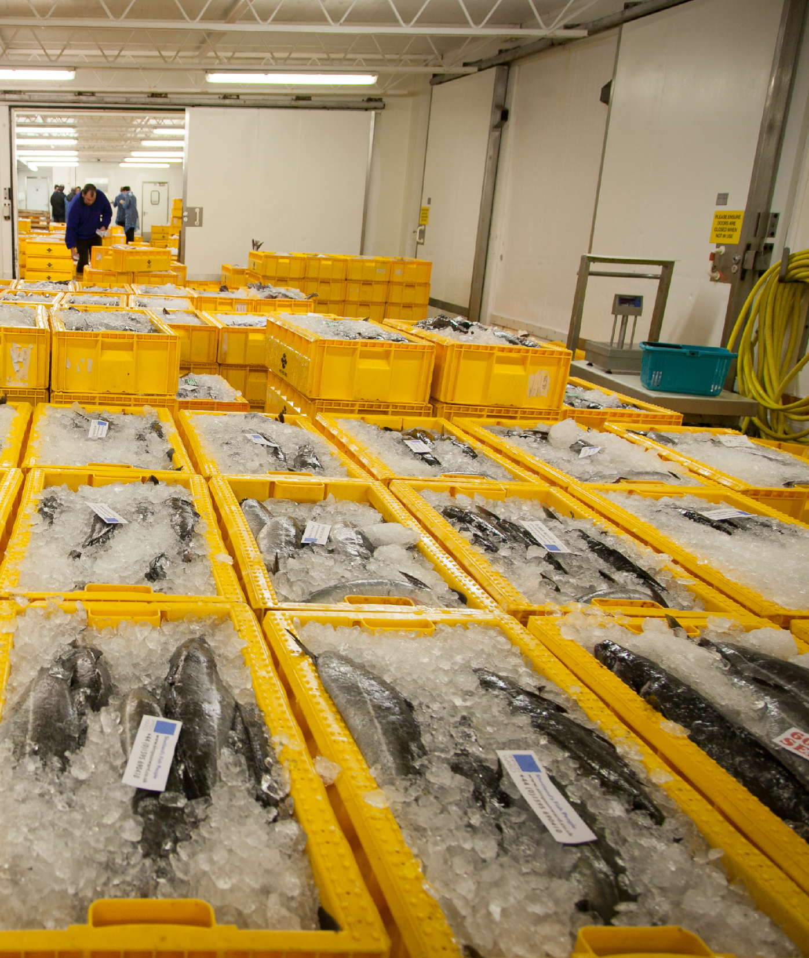


Premises Inspections

Slide 2
Premises Inspections
Compliance inspections
  Why we inspect premises
  Powers we use
  Types of Premises
  Infringements

Slide 3
Premises Inspections
Why do we Inspect Premises?
  To determine species and quantities of fish on premises
  To ensure fish are above MCRS and not protected
  To determine the origin of fish
  To confirm if RBS registered and compliant

Slide 4
Premises Inspections
Powers
  Common Enforcement Powers MaCAA
  247 Power to enter and inspect premises
  (not a dwelling!)
  250 Powers of search, examination, etc
  251 Power to require production of documents, etc
  252 Powers of seizure, etc
  254 Retention of seized items

Slide 5
Premises Inspections
MCRS checks
  Identify species (protected or quota restricted?)
  Gauge and measure
  Count boxes, bags and other containers (check weighing?)
  Landing obligated?
  Seize fish?

Slide 6
Premises Inspections
Assessment of species and quantities
  Visually inspect all fish storage areas
  Determine species present
  Count boxes, bags and other containers (check weighing?)
  Obtain estimate of quantities held on premises

Slide 7
Premises Inspections
Determine origin of fish
  Ask questions and take notes (Caution?)
  Check purchase invoices, delivery notes, etc.
  Check sales notes
  Cross reference with other statutory documents (logbooks, takeover documents, sales notes)

Slide 8
Premises Inspections
Types of Premises
  Harbour cold stores
  Fish markets
  Fish wholesalers
  Fish processors
  Fish retailers
  Aquariums,

Slide 9
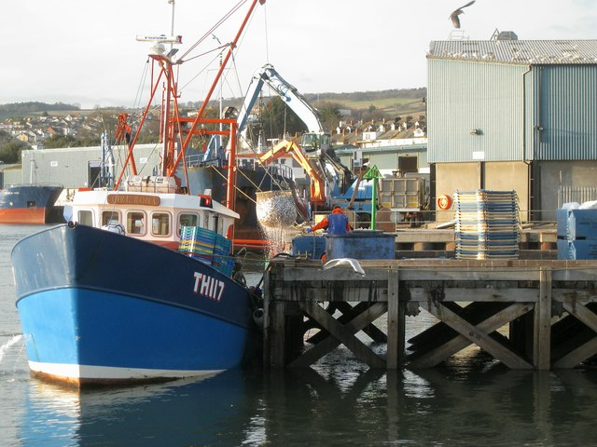
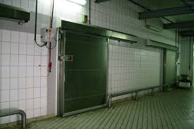
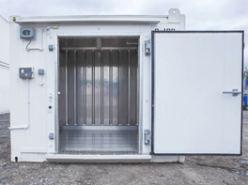
Premises Inspections
Harbour cold stores

Slide 10
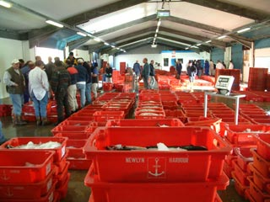
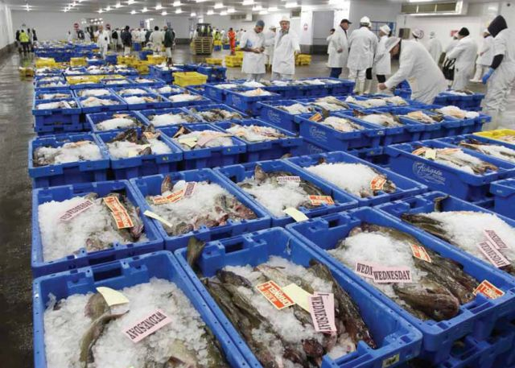
Premises Inspections
Fish Markets

Slide 11
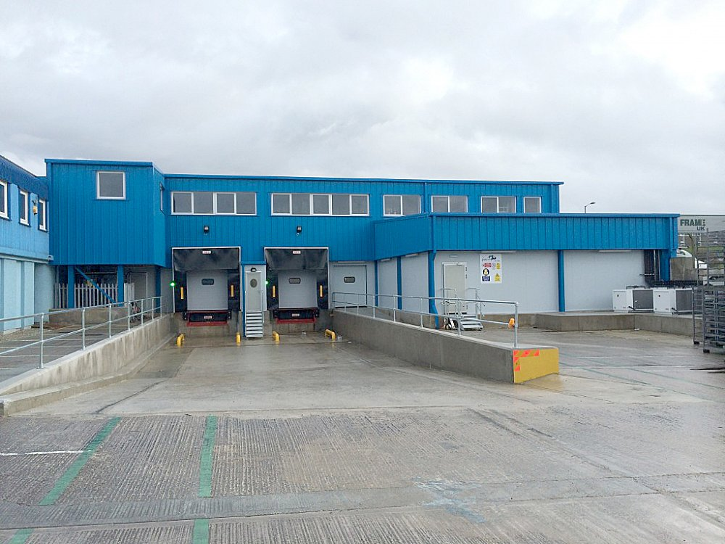
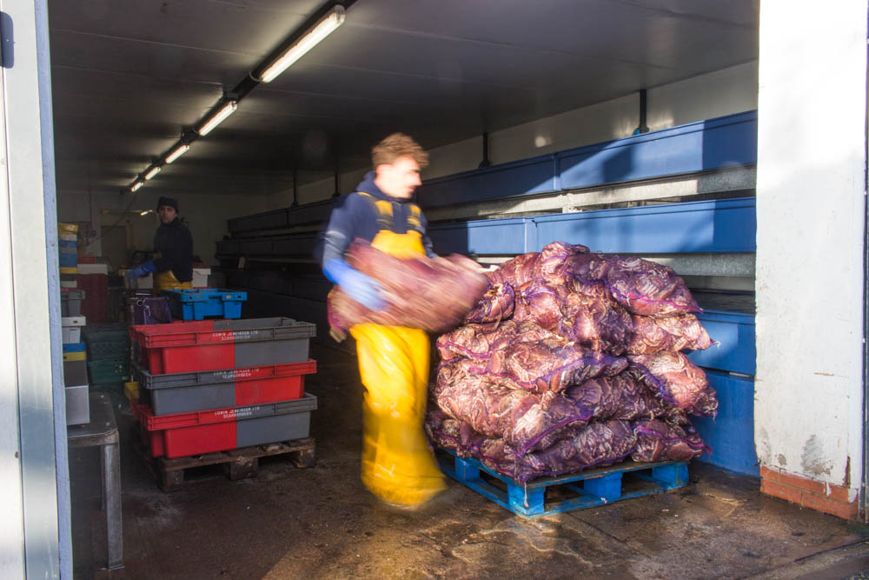
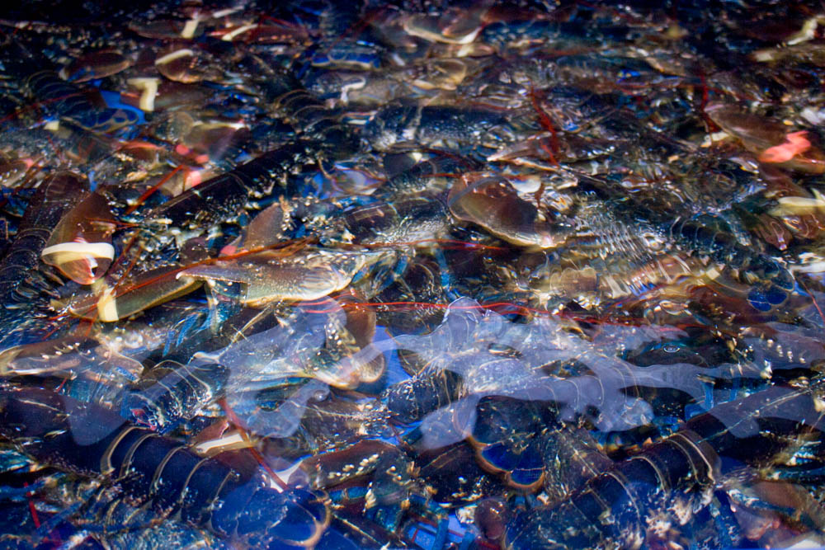
Premises Inspections
Fish Wholesalers

Slide 12
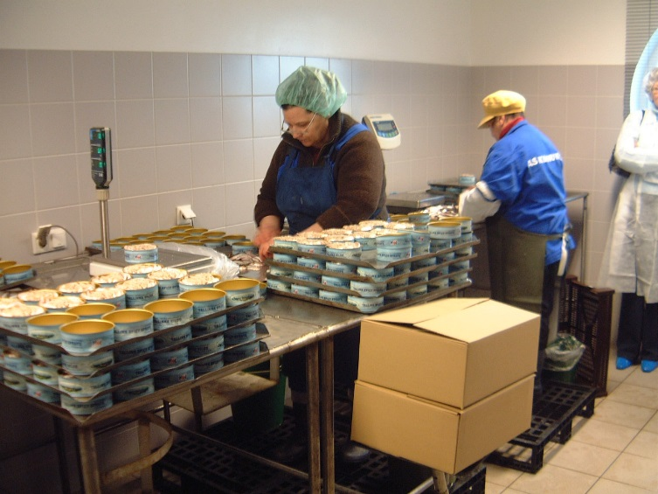
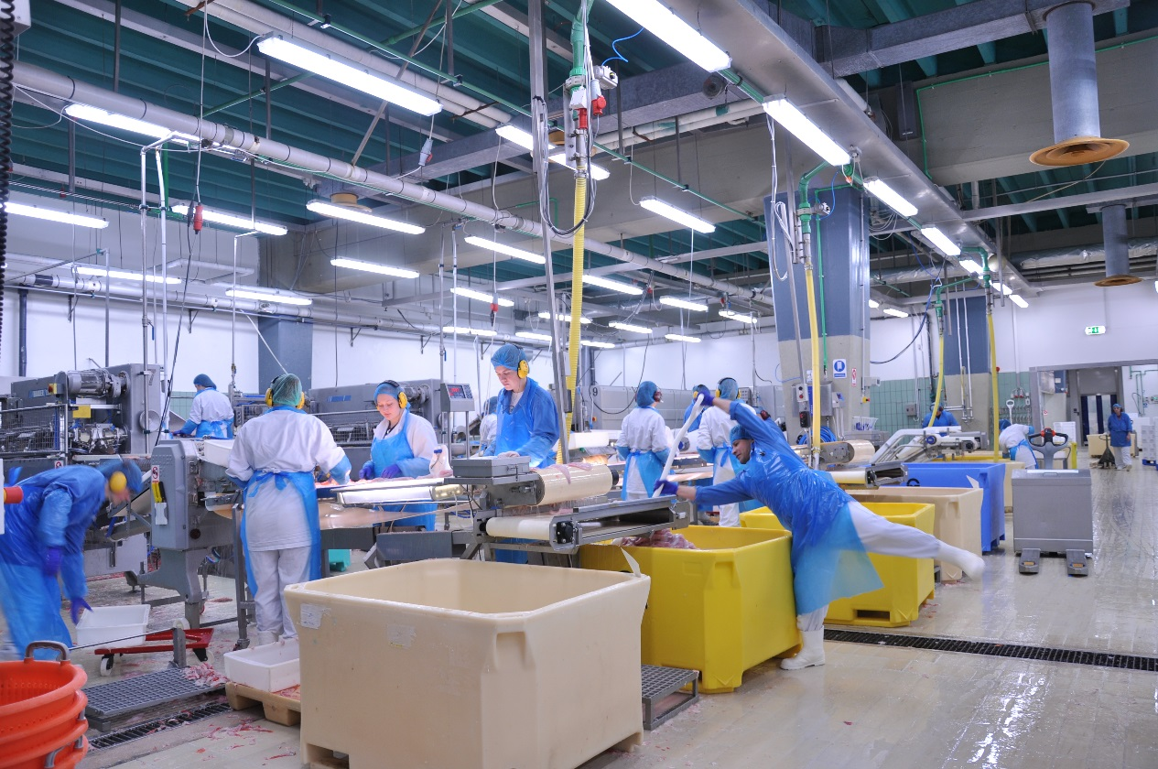
Premises Inspections
Fish Processors

Slide 13
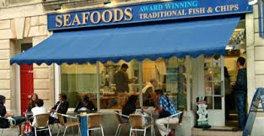
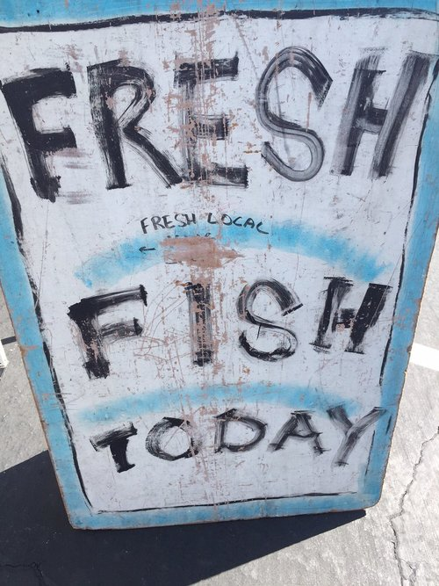
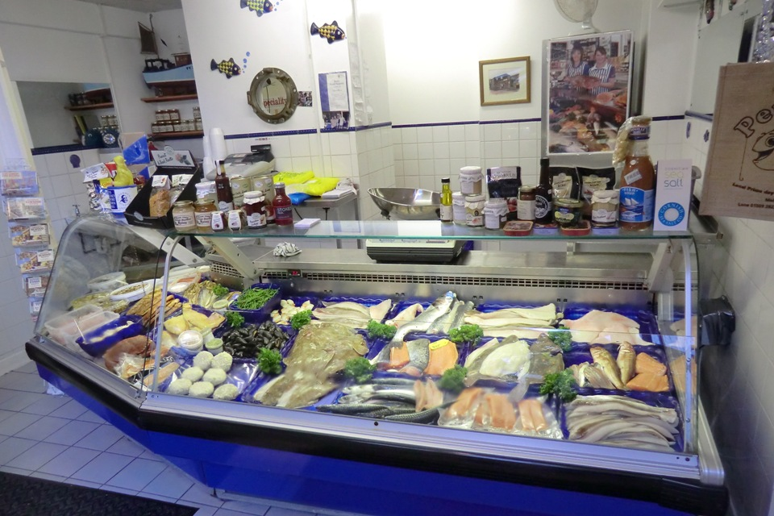
Premises Inspections
Fish Retailers

Slide 14
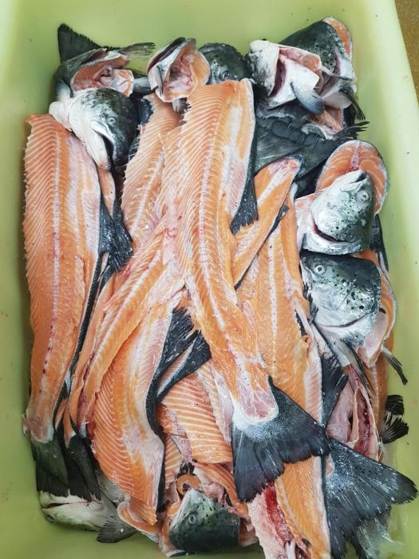
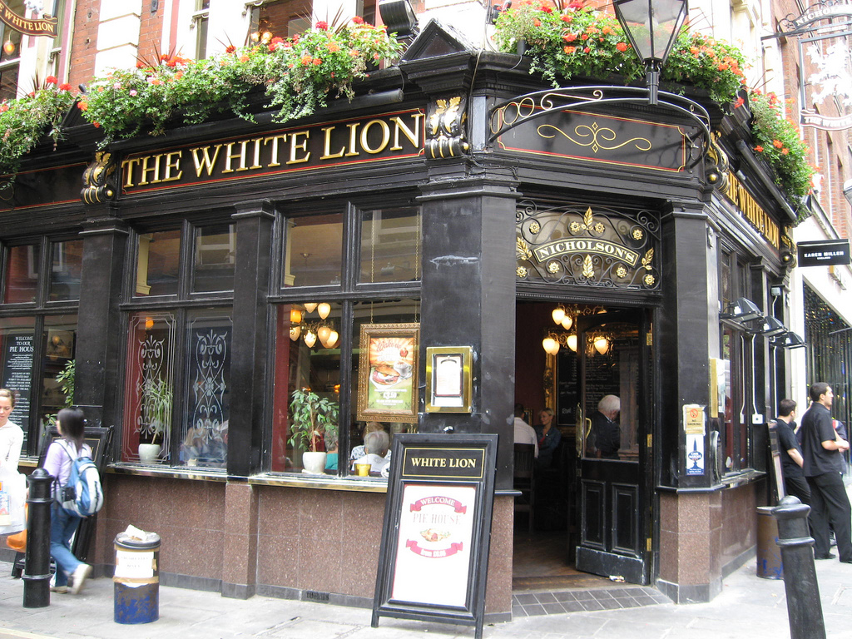
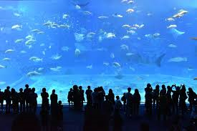
Premises Inspections
Others
Notes:
Aquariums
Fish waste

Slide 15
Premises Inspections
Are they RBS registered?
  Check before you inspect!
  Where is paperwork kept?
  Do they purchase direct from fisherman?
  Cross reference with other statutory documents (logsheets, takeover documents, sales notes)

Slide 16
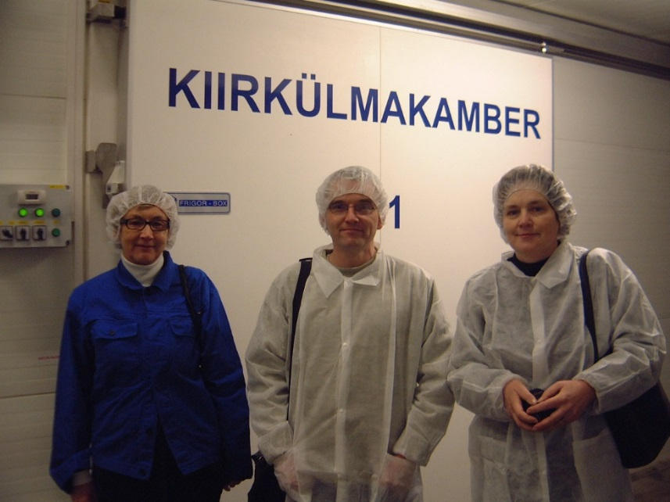
Premises Inspections
Other considerations
  Health and Safety
  Consider interference to the business
  PPE and hygiene
  Work in pairs (cash)

Slide 17
Questions

