Slide 1

Witness Statements

Slide 2
What is a witness statement?
Document providing details of an event / events
Includes events which have taken place as part of (or have relevance to) an investigation
Mechanism by which a person’s evidence is provided
Can be used as evidence to the court without the witness needing to attend.
Witness statements are an integral part of any case file
Notes:
A witness statement is a document providing details of an event or set of events which have taken place as part of (or have relevance to) an investigation. If a statement is provided in accordance with certain requirements, it can be used as evidence to the court without the witness needing to attend. A witness statement can come from an investigating officer a civilian or an expert witness, but it must always be provided in the same format and on the same forms in order to comply with the rules of evidence

Slide 3
What is a witness statement?
Made by officers involved in case or third parties
Set format - written on prescribed form – (MG11)
Third party witnesses will also need witness details (MG11B)
Printed single sided
Notes:
MG- Manual of Guidance home office o=approved forms used by police in England and Wales – adopted by MMO & WG for out investigations

Slide 4
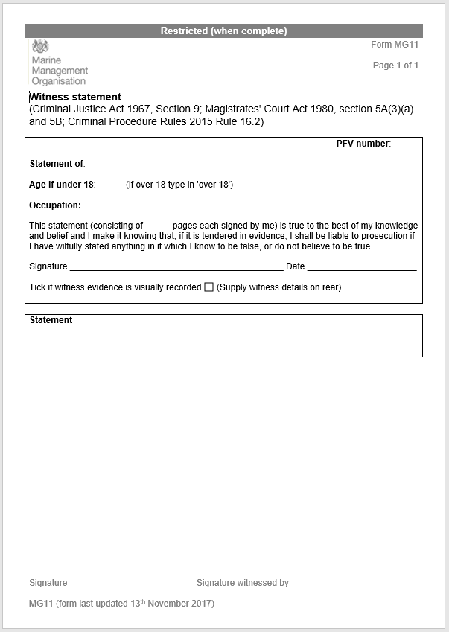
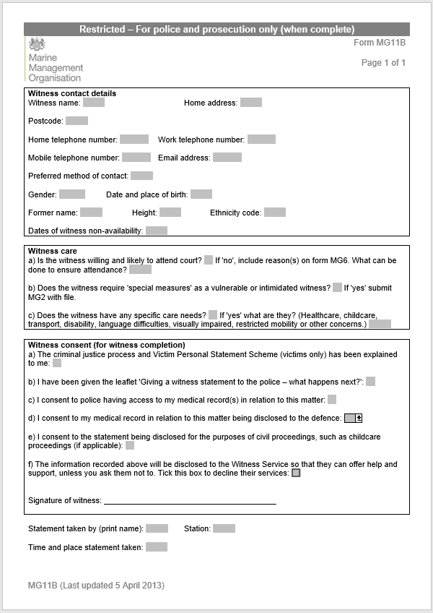
MG11 MG11B

Slide 5
Writing
Statement is yours and no one else’s, do not collude with others when writing
Written in clear English – Magistrates, Judges or the jury are laymen and will have no prior knowledge of the case
Should be detailed and not require any further explanation or clarification
Only include relevant information
(e.g. don’t talk about fish-weighing procedure in inspection if the case is for a net offence)

Slide 6
Writing
Start with very brief introduction about yourself
“I am a Senior Marine Officer and I work for the Marine Management Organisation based in the Preston Office.
Doesn’t need a long introduction to what the statement relates to, as it is part of a case file that will include MG5.
Should not contain hearsay, assumptions, opinions or inferences – stick to the facts!
Set out logically and chronologically
Each page numbered and signed (signed only by you)
MG5 = Case summary

Slide 7
Writing
You should consider how your evidence relates to the point to prove
State what you did in relation to the points to prove.
Do not go into detail about background information that does not help prove the offence.
If you need to explain what you were doing in an inspection to show timeline but it is not relevant to the offence keep it brief:
  “ I then inspected the gear and found nil infringements”

Slide 8
Common Mistakes
Hearsay
“I spoke to Mr Alan Fisher on the 18th of September 2016. He told me that he had seen a digger on the beach. The digger was being operated by a man in an Acregate Aggregates jacket and was removing shingle from the foreshore.”
For the above to be used as evidence it needs to be in a witness statement from Alan Fisher.
What would you do if he refuses to supply a statement?

Slide 9
Common Mistakes
MG5 in the statement
You should not explain all the evidence in one persons statement.
The evidence should be brought together and explained in the MG5 not in one officers statement.
In some investigations one officer my produce all the evidence in their statement but it will be explained in full in the MG5.

Slide 10
Common Mistakes
Emotive language
Despite
Blacking
Apparently
Claimed
Likely
Appears
Assume

Slide 11
Common Mistakes
Logistics or admin in the statement
“I sent an email to Marine Officers to check their availability for the inspection”
“ I wrote a letter inviting Mr Collins to attend an interview on the 25 January 2016. They responded on the 17 January 2016 stating they could not attend. I phoned Mr Collins and asked what date he could attend. He agreed to attend interview on the 27 January 2016. On the 27 January 2016 Mr Collins arrived at the office at 10:25.”
The above is unnecessary.

Slide 12
Common Mistakes
Acronyms
Do not refer to acronyms without explaining them:
  includes RBS, MCSS, MCMS, MMO, MO, MEO.
Do not put officers’ names as acronyms.
“I saw MO Daniel Tilly (DT) measure the net. I wrote down the results as DT read them out to me”
I saw Marine Officer (MO) Daniel Tilly measure the net. I wrote down the results as MO TILLY read them out to me”

Slide 13
Common Mistakes
FAO codes
“I recorded that there was 800 kg LEZ on the logbook.”
Should be:
“I recorded that there was 800 kg of megrim on the logbook.”

Slide 14
Common Mistakes
Time
Seeing sentences like this:
“At about 15:23 I boarded the vessel”
If you wrote the time in your note book use that time.
“At 15:23 I boarded the vessel”
If the notes were made after the initial inspection and you estimated the time in your notebook then use estimates.
“ I entered the wheelhouse at about 15:35”

Slide 15
Common Mistakes
Commenting on other peoples exhibits
Only done for expert witness statements
Drawing together evidence should be in the MG5

Slide 16
Common Mistakes
Intelligence
If you are acting on intelligence you should not refer to this in your statement.
Simply state that you were inspecting the vessel, vehicle or premises. It is your job to carry out inspections.
Neither should you include any intelligence you have received as part of the inspection/investigation

Slide 17
Common Mistakes
MG6C
schedule of non-sensitive unused material
Interview
Description of how the interview was setup and the steps taken are not required.
The transcript/SDN must be produced as an exhibit by whoever writes it. There is a section on the form for the exhibit reference number.
Do not produce the CD recording it will go on the MG6c.
Do not comment on what was said in your statement unless it leads to further lines of enquiry.
State the date of interview, what your role was, who else was present and time it started and ended.

Slide 18
Common Mistakes
Databases
Getting information from the incorrect database. Make sure you use the correct source, for example FishHub for e logs.
Using the jargon name for the database which is meaningless to a lay person. Simply state from the MMO database or state the name of the database with a brief explanation of what the database contains.

Slide 19
Style
General
Write in the first person
Write in the past tense for what you did
Sentences should be short
Numbers should be written as numerals

Slide 20
Style
Tables
The only tables that appear in the body of your statement should be for producing multiple exhibits. You would need to be producing 15 plus exhibits of the same type before this would be considered. You will need to speak to Joe to get the Macros unlocked.
A table which performs analysis is an exhibit and should be produced accordingly.

Slide 21
Style
Species
Use the common name of the species; Latin names are not needed as standard.
The Latin name will only be needed if there is likely to be dispute regarding the species involved or needs explaining due to it being in a piece of evidence.
In this case use the common name followed by the Latin in brackets, for example ‘cod (Gadhus morhua)’.
Only use the Latin name once, unless evidence requires otherwise.

Slide 22
Style
Names
The first time you refer to a person you should write their full name there after it is recommended you use their surname only.
Surnames of people should be capitalised.
Example:
“I introduced myself to the master of the vessel, Dennis James SUGDEN. I requested that he haul his gear so that I could perform an inspection. SUGDEN refused to comply with my request.”

Slide 23
Procedures In Statements
Only procedures relevant to the offence should be included.
The procedure should be written out succinctly.
If the same procedure is used repeatedly in the inspection it only needs to be described once, the first time.

Slide 24
Procedures In Statements
Example 1
“I measured the fish in accordance with procedures, to check for minimum conservation reference size.”

Slide 25

Procedures In Statements
Example 2
I measured the sole to check they complied with the minimum conservation reference size (MCRS). I used a measuring board, placing the sole’s head at the end of the board, kept the sole straight and smoothed the tail of the fish out. I then noted the length of the fish rounding up to the nearest whole cm. I made a note of the fish’s length and whether it was over or under the MCRS.

Slide 26
Procedures In Statements
Example 3
“I measured the sole to check they complied with the minimum conservation reference size (MCRS). MCRS is in place to reduce the numbers of juvenile fish which are caught and ensure there is a spawning stock. In order to assess the MCRS I used a fish measuring board. The board consists of a flat vertical plate and a flat horizontal plate which has a mark at every cm. The total board length was 60cm. I placed the sole on the fish measuring board, ensuring that the tip of the fish was pushed up to the vertical board, I straightened the fish out along the board and then thoroughly smoothed out the fish’s tail. I then rounded the length of the fish up to the nearest whole cm. This gives the fishermen the benefit of the doubt. So if the fish sits between 1cm under MCRS and the MCRS length it will get the MCRS length, even though it was below. This is done to be as fair as possible.”

Slide 27
Exhibits
Specific items or documents referred to in a statement
Any document or object referred to as an exhibit and identified in the statement will be treated as if it has been produced by the person who made the statement

Slide 28
Producing Exhibits
General
Describing an exhibit:
All exhibits referred to should be described.
The description should be unique to that exhibit.
It should allow a reader to be able to identify the exhibit as if there was no label on it.
Keep description succinct & match the exhibit label.

Slide 29
Producing Exhibits
General
You should state how you found the evidence or made the exhibit.
You should ‘produce’ the exhibit.
Where possible be produced in chronological order
You should give the exhibit a reference number made up of your initials
Example:
I found a diary in the wheelhouse of the fishing vessel Pickled Pear PN2. The diary is bound in a red cover, for the year 2020 with PP handwritten on the front, which I produce as exhibit JLW01.

Slide 30
Producing Exhibits
Singular
I produce a sales note for the Tickled Pear PN2 as JLW02.
I produce a sales note dated 21.09.2016 for the fishing vessel Pickled Pear PN2 , with total value £365 as exhibit JLW02.
I produce a sales note for the Pickled Pear PN2, dated 21.09.2016, for 20kg cod at £40, 30kg sole at £225 and 10kg of sea bass for £100, with a total value of £365 as exhibit JLW02.

Slide 31
Producing Exhibits
Multiple
Exhibits are often produced in groups.
For example all the sales notes for a vessel in a set period.
“ I retrieved the sales notes for the Pickled Pear PN2, they were for the 2, 5 and 6 of October 2016. These are produced as exhibits JLW01, JLW02 and JLW03.”
They should all be produced separately and each described appropriately.

Slide 32
Producing Exhibits
On the 20th October 2016 I looked at our records for sales notes for the Pickled Pear PN2. I extracted those which were dated between the 1 October and 7 October. There were three in total. I made copies of the sales notes.
I produce a copy of a sales note for the Pickled Pear PN2 dated the 2 October 2016, for a total value of £230 as exhibit reference JLW01.
I produce a copy of sales note for the Pickled Pear PN2 dated the 5 October 2016, for a total value of £154 as exhibit reference JLW02.
I produce a copy of the sales note for the Pickled Pear PN2 dated the 7 October 2016, for a total value of £188 as exhibit reference JLW03

Slide 33
Exhibits contained in another item
Some exhibits are contained in another item.
A page of a logbook
2 or 3 pages from a lever arch file.
The finder in their statement should reference the original object, do not produce it:
“I seized a logbook from the wheelhouse of the Pickled Pear PN2, which I gave reference number JLW08.”
The officer exhibiting the material should exhibit the relevant page:
“ I examined JLW08 and copied logbook page GBR1002352, showing the vessel departed port on the 12 October 2016, which I produce as exhibit reference AGN01.”

Slide 34
Printed or copied exhibits
Some exhibits are printed or copied from another source.
Sources could include:
databases
memory cards
paper records
You must make it clear in your statement that you are exhibiting a copy.
“I went onto the online database called FishHub, which contains records of electronic logbooks. I located the electronic logbook for Leviathan FD23 with trip start date 21 June 2019 and printed it out. I produce a printed copy of the electronic logbook for the Leviathan FD23 with reference number C123456789 and trip start date 21 June 2019 as exhibit JZW01”.

Slide 35
Analysing exhibits
You should highlight what is important about the evidence, do not go into lots of detail. The case for the evidence will be made in the MG5.
Example:
Sales note showing quota overshoot:
“The sales note shows that the total amount of cod landed by the vessel was 600 kg, in excess of the monthly quota allocation of 300 kg”
Where you are comparing or analysing multiple exhibits consider if you can do it in a table and produce that as an exhibit in it’s own right. This analysis should be factual
Do not make opinions on what it shows. It would then become an expert’s witness statement.

Slide 36
Notebooks as exhibits
Notebooks should not be routinely exhibited. Exceptions may include:
  Master’s signature agreeing results.
  If the defence dispute the notebook, will be a supplementary statement
The notes are what make the basis of your statement
Your statement will reflect the relevant content of your notebook.
A copy will be entered on the MG6c schedule
Only exhibited when the defence dispute your version of events.
MG6C
schedule of non-sensitive unused material

Slide 37
Witness Statements - taking
Occasionally you may need to take a statement from a third party witness
Treat as an interview in terms of planning
- what you know
- what you need to know
Inform them of potential implications – court!
Discuss evidence with the witness before writing
You may write statement for them, but it is ultimately there’s to agree content of and sign

Slide 38
ADVOKATE
A Amount of time under observation
D Distance – how far away was the witness
V Visibility – what was the visibility at the time?
O Obstruction – were there any obstructions to the witness’ view.
K Known or seen before – Is the person known to the witness or seen previously. If so where, when or why?
A Any reason to remember? A special reason for remembering the incident/person?
Did something specific make it memorable?
T Time lapse - how long has elapsed since the person saw the incident/person?
E Error – are there any errors or discrepancies between the witness’ first account and subsequent accounts.
Notes:
From r v Turnbull - Although the actual case law applies to descriptions of the person, the principles do apply to any description either person, object, or event

Slide 39
Disclosure
Any drafts which have annotation put on MG6 schedules
All drafts that are significantly changed must go on the MG6 schedules.
All signed statements that become unused must go on the MG6 schedules.
MG6 Confidential information

