Slide 1
Cautioning

Slide 2
Cautioning
Why do we interview ?
Investigators have a duty to allow a suspect the opportunity to answer the allegations against them and give their own account before a decision on prosecution is made.
What information might an interview under caution provide?
important evidence for or against the suspect;
important information revealing further lines of inquiry;
relevant information to be considered in the prosecution and courts decision.

Slide 3
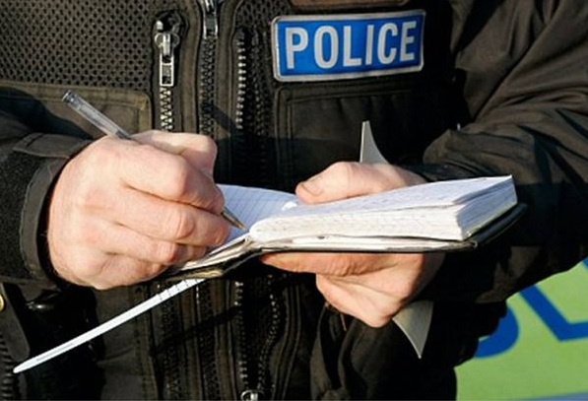
Cautioning
Why do we caution?
To advise the suspect that what they are saying may be used as evidence in an investigation
So there are no doubts that what they are saying is admissible
Some legal protection for the officer

Slide 4
Cautioning
When do we caution?
When there are grounds to suspect a person has committed an offence
and
If you wish to put questions to the suspect regarding a suspected offence
or
If the suspect engages you in conversation regarding a suspected offence
Notes:
Give an example – measuring a net.

Slide 5
Cautioning
When do we not need to caution?
When establishing a suspect’s identity or ownership details
When obtaining information in accordance with any statutory requirement
When questioning a suspect in the furtherance of conducting an effective search
When seeking verification of a written record
When questioning anyone else about an offence

Slide 6
Cautioning
Grounds for suspicion
Needs to be more than a ‘hunch’
Some evidence
Less evidence than for a prosecution
Preliminary questions (name etc.) may turn into questioning that requires the caution

Slide 7
Cautioning
The Caution
“You do not have to say anything, but it may harm your defence if you do not mention when questioned something which you later rely on in court. Anything you do say may be given in evidence.”
Notes:
Can anyone recite the caution?

Slide 8
Cautioning
Understanding the caution
Essential that suspect understands the meaning of the caution before questions are put to them
If there is any doubt about their understanding then evidence gained could be deemed inadmissible
PACE says that if it appears that they do not understand the caution, you should explain it in your own words
Therefore you must understand the caution yourself!
For audio-recorded interviews, explain every time regardless of their apparent understanding

Slide 9
Cautioning
Explaining the caution
Best to split it into three parts:
1. “You do not have to say anything”
You can choose to remain silent, and you can choose to answer all, some or none of my questions

Slide 10
Cautioning
Explaining the caution
Best to split it into three parts:
2. “But it may harm your defence if you do not mention when questioned something which you later rely on in court”
If you fail to explain something to me now, a court may come to their own conclusions and may not accept any explanation you give at a later date.

Slide 11
Cautioning
Explaining the caution
Best to split it into three parts:
3. “Anything you do say may be given in evidence”
Anything you say to me whilst under caution can be used in court as evidence against you or in your favour

