Slide 1



INTELLIGENCE REPORTS (IR)

Slide 2
National Review of Intelligence Report
Used to be called a National Information Report (NIR) or 5x5x5
Now called Intelligence Report (IR) or 3x5x2
Not called a SAR

Slide 3
Conclusions and Development
Findings gave mandate to change
Evolution not revolution, Clarity and simplicity
Handling code needs to reflect ‘dare to share’ philosophy
Agencies (partners) need to be included
Concept of new Intelligence Report emerged
Drafted into APP (Authorised Professional Practice)
APP agreed by College of Policing Aug 2015 and now national policy.
To be fully implemented nationally by April 2017

Slide 4
Changes
Retain the principles within the National Intelligence Model (NIM)
Report of source evaluation, information assessment and handling codes
Refine Information Management Codes
Use ‘plain English’
New name of Intelligence Report (IR) - not NIR, 5x5x5 or 3x5x2.

Slide 5
Impact of changes
Strengths Simpler and clearer (plain English) Not police-centric Easier to use and train Faster command assessment and decision making Encourages intelligence submissions Improves accuracy of intelligence grading at submission Reduced administration and re-working Encourages intelligence sharing Able to customise sharing conditions Confident management of risk, threat and harm Additional source protection | Challenges Staggered introduction as forces and agencies implement Dealing with risk in moving from “need to know” to “dare to share”.

Slide 6
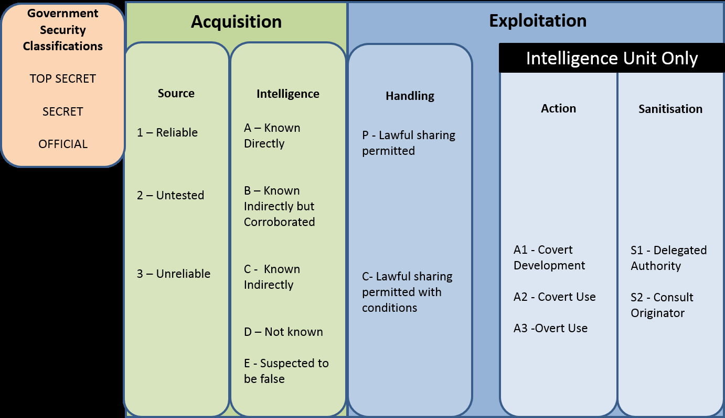

Slide 7
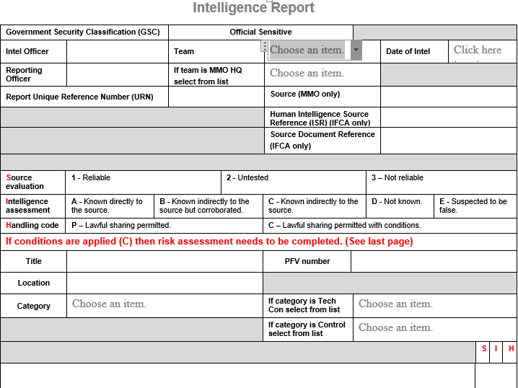
Intelligence Report

Slide 8
So having received information what do we evaluate first?

Slide 9
Source Evaluation
1. Reliable
3. Not reliable
2. Untested

Slide 10
Source Code - Reliable
Used where the source is believed to be competent and information received is generally reliable
May include information from human intelligence, technical, scientific and forensic sources
E.g. Fisherman you have know for a number of years and trust

Slide 11
Source Code - Untested
A source that has not previously provided information TO THE PERSON RECEIVING IT or has provided information that has not been substantiated
Source may not necessarily be unreliable, but info provided should be treated with caution.
Before action corroboration should be considered
To be used where source cannot be determined
E.g. An anonymous phone call into your office

Slide 12
Source – Not Reliable
Use where there are reasonable grounds to DOUBT THE RELIABILITY of the source.
Risk Assessment required to identify concerns re authenticity, trustworthiness, competence or motive of the source, or the confidence in any technical equipment.
Corroboration should be sought before acting on this information
E.g. Local fisherman with a criminal record who is trying to eliminate competition by making exaggerated or false claims.

Slide 13
What do we evaluate next?

Slide 14
Intelligence Evaluation
Known directly
B. Known indirectly but corroborated
C. Known indirectly
D. Not known
E. Suspected to be false

Slide 15
A – Known Directly to the Source
Refers to Information obtained FIRST HAND (i.e. through witnessing it)
Take care to differentiate between what a source witnessed themselves and what they were told or heard from a third party

Slide 16
B – Known indirectly to the Source – but corroborated
Refers to information the source has NOT witnessed themselves – but;
The reliability of the information can be verified by separate information that carries the information/intelligence assessment of ‘A’
Could be from technical sources, other intelligence, investigations or enquiries. (Need to identify how in risk assessment). Take care to ensure corroboration presented is independent & not from original source

Slide 17
C – Known Indirectly to the Source
Information the source has been told by someone else
The source does not have first hand knowledge of the information as they did not witness it themselves

Slide 18
D – Not Known
Where there is no means of assessing the information
Could be – from Anonymous source, Crimestoppers etc, where unable to question the source to establish the true provenance

Slide 19
E – Suspected to be False
Regardless of how the source came upon this information – there is reason to believe the information provided is false.
Where this is the case, the rationale for WHY it is believed to be false should be documented in the Intelligence Risk Assessment

Slide 20
What do we evaluate last?

Slide 21
Handling Code
Lawful sharing permitted
C. Lawful sharing with conditions

Slide 22
Code P: Lawful sharing permitted
In order to share this intelligence there must be:
a policing purpose
local protocols in place
a legitimate need to receive it.
Dissemination questions:
are there legal obligations?
who is asking for it?
why do they want it?
what are they going to do with it?
Lawful sharing includes other government departments, private and voluntary sectors.
If there are concerns around how widely the intelligence may be disseminated, or how it is used, Code C applies

Slide 23
Dissemination Code C - Conditions
Requires receiving agency to Observe Conditions
IR Risk Assessment required in all cases
PII application if intelligence is to be used in Court proceedings
Originator to be contacted before any use outside of conditions stated
To remain under review and change when circumstances no longer require conditions
PND !!

Slide 24
Risk Assessment – Form ‘C’
Revised Form C for supporting information and risk assessment – accompanies the IR
Supporting information made simple and easy to use:
  If the information is suspected to be false: WHY?
  If the source is unreliable: WHY?
  If there are handling conditions necessary: WHY?
Risk Assessment clearer for Intelligence Unit use
  Bullet point style
  Clear - simple questions

Slide 25
Authorisations
Each organisation should develop a policy to ensure suitable levels or authorisation for the dissemination of intelligence. Consideration should be given to:
Dissemination to non-EEA countries
Dissemination to non-prosecuting parties.

Slide 26
Action and sanitisation codes
A1 Covert Development - Intelligence may be combined or corroborated with other intelligence but action cannot be taken directly. Permission must be sought from the originator before action is taken on any derived intelligence.
A2 Covert Use – covert action - Covert action may be taken on this intelligence although the source, technique and any wider investigative effectiveness must be protected. This intelligence may not be used in isolation as evidence, in judicial proceedings or to support arrest.
A3 Overt Use – overt action - is permitted on this intelligence to be specified by Intelligence Source owner.
S1 Delegated Authority - the originator of the intelligence permits the unsupervised sanitisation of the material in order to allow dissemination to a wider audience.
S2 Consult Originator - the originator of the intelligence does not permit the sanitisation of the material for wider dissemination without consultation being sought.

Slide 27
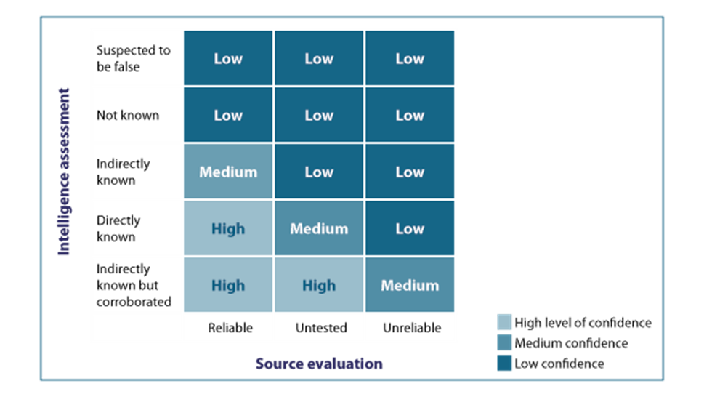
Intelligence confidence matrix

Slide 28
A few definitions
Source
  Could be you, anyone that tells you information, crimestoppers or another LEA or organisation
Reporting Officer (sometimes referred to as recording officer)
  You
Submitting Officer
  You or your local Intelligence Officer

Slide 29
Example
An anonymous phone call was received by Officer Beattie stating ‘Jason Bourne drives a red car’
  Source = the anonymous caller
  Reporting Officer = Officer Beattie
  Submitting Officer = Local Intel Officer who creates report and sends to central intel team

Slide 30
Example
Officer Beattie sees John Smith driving a red van
  Source = Officer Beattie
  Reporting Officer = Officer Beattie
  Submitting Officer = Either office Beattie or local Intel Officer

Slide 31
Example
Mrs Laura Potter tells Officer Beattie that Mark Green delivers fish to the back door of a restaurant next to her café in the High Street
  Source = Laura Potter
  Reporting Officer = Officer Beattie
  Submitting Officer = Either officer Beattie or local Intel Officer

Slide 32
Current intelligence gathering operation
Criminal network catching and distributing undersized lobsters
Delivery driver identified as a known ‘rogue’ Jason Bourne
Officers were tasked to find out what vehicle Jason Bourne drives

Slide 33
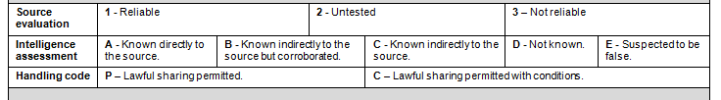
“Jason Bourne drives a red car”
(No evaluation recorded)
How reliable is the source of this information?
  We do not know
How sure is the source on the legitimacy of this information?
  We do not know
How sensitive is this information? Can we share it?
  We do not know

Slide 34
“Jason Bourne drives a red car”
Evaluated as ‘1AP’
How reliable is the source of this information?
  Good, reliable
How sure is the source on the legitimacy of this information?
  Very sure – this is known directly to the source but not the officer
How sensitive is this information?
  Not very, can be disseminated to other UK Law enforcement agencies*

Slide 35
“Jason Bourne drives a red car”
Evaluated as ‘2CP’
How reliable is the source of this information?
  We do not know, the source untested.
How sure is the source on the legitimacy of this information?
  We do not know, the source does not know this directly but may have been told by a third party
How sensitive is this information?
  Not very, can be disseminated to other agencies*

Slide 36
Telephone call
An unknown person telephone’s the office to provide some information
An officer who receives the call makes some notes in their note book

Slide 37
So what do you need to do?
Protect yourself:
  Document the conversation in detail
  Record full details of the source
  Unknown 5WH are a good thing = intel gaps
  Create and evaluate intelligence report

Slide 38
Protection of the Source
Duty of care
The ownership of the risk to the source always remains within the originating organisation.
When intelligence is disseminated outside the originating organisation, any handling conditions must be adhered to by the receiving organisation. When this doesn’t happen, both organisations may be held accountable for any consequences.
From College of Policing AuPP

Slide 39
Remember
The MMO and IFCA are not authorised to handle human intelligence sources under RIPA (CHIS).
Obtain as much information as possible the first time as we may not be able to go back and ask further questions.
We cannot task them to find out further information by using a relationship.

Slide 40
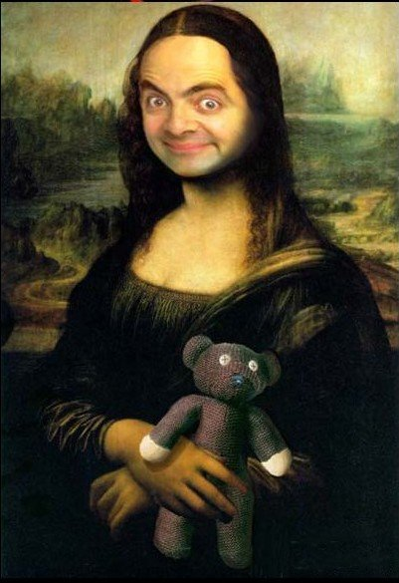
What is Provenance?
Errors made in the early stages of what we collect, and how we collect it, may be significant!
For instance:
How do you establish the Provenance of the Mona Lisa?
What is its history?
Where did it come from?
How do we know its origins?
Does it have a Certificate of Authenticity?
5 x W H.

Slide 41
5 x W H
Always ask the source:
How do they know this information?
Who else knows it? (were other persons present)
When did they know this? (last week / year?)
What did they see or hear? (witness first hand/ overheard?)
Where did they see / hear this?
Why is it happening
What action, if any, do they expect?

Slide 42
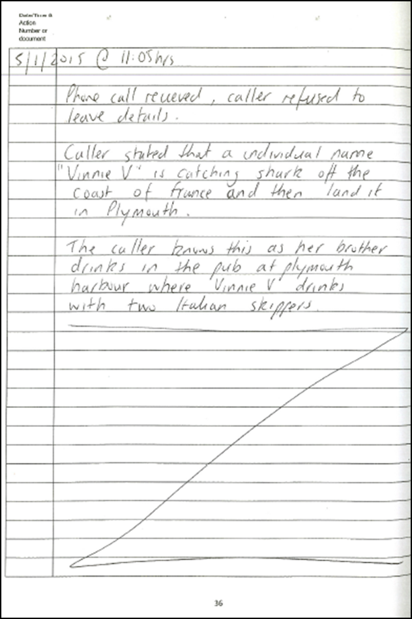
Information and source document
Date & time
5/8/2016 @ 11:05
Phone call received, caller refused to leave details.
Caller stated that an individual named ‘Vinnie V’ is catching shark off the coast of France and then landing it in Plymouth.
The caller knows this as her brother drinks in the pub at Plymouth harbour where ‘Vinnie V’ drinks with two Italian skippers
‘Z’ off page
Page number

Slide 43
Evaluation of Source
5/8/2016 @ 11:05
Phone call received, caller refused to leave details.
Caller stated that an individual named ‘Vinnie V’ is catching shark off the coast of France and then landing it in Plymouth.
The source is the first part to be evaluated.
Who are they?
Have they reported information in the past?
Source

Slide 44
Evaluation of the information
Caller stated that an individual named ‘Vinnie V’ is catching shark off the coast of France and then landing it in Plymouth. C
The caller knows this as her brother drinks in the pub at Plymouth harbour where ‘Vinnie V’ drinks with two Italian skippers C

Slide 45
What is Sanitisation?
What are the two aims of sanitisation?
To protect the source of the information
To make available (share) as much information as possible so action may be taken

Slide 46
Sanitisation
Caller stated that an individual named ‘Vinnie V’ is catching shark off the coast of France and then landing it in Plymouth.
‘Vinnie V’ is catching shark off the coast of France and then landing it in Plymouth
The caller knows this as her brother drinks in the pub at Plymouth harbour where ‘Vinnie V’ drinks with two Italian skippers
‘Vinnie V’ drinks with two Italian skippers in a pub at Plymouth harbour

Slide 47
Evaluation of the Handling Code (Dissemination)
Caller stated that an individual named ‘Vinnie V’ is catching shark off the coast of France and then landing it in Plymouth. 2C
Vinnie V’ is catching shark off the coast of France and then landing it in Plymouth
The caller knows this as her brother drinks in the pub at Plymouth harbour where ‘Vinnie V’ drinks with two Italian skippers. 2C
‘Vinnie V’ drinks with two Italian skippers in a pub at Plymouth harbour .
Now this is sanitised can we share this with other LEA’s?

Slide 48
Where does my information go?
Dissemination
Aims to influence decision making
Intelligence products that remain locked up in Intelligence Units do not achieve the primary objective of intelligence
Dissemination ensures that completed intelligence products are circulated to those that need to see it

Slide 49
Why are we doing this?
To create a searchable central intelligence database
To share intelligence between ourselves and other law enforcement agencies
To enable further Intelligence checks to be undertaken
Assist in the creation of Intelligence packages
Enable a Strategic Assessment to be written and decide our priorities
Identify any emerging issues to enable a tasking meeting to make informed decisions

Slide 50
Any questions?

