Slide 1
Regulation of Investigatory Powers Act 2000 (RIPA)

Slide 2
RIPA
Human Rights Act 1998
Article 8 provides that:
(1) “Everyone has the right to respect for his private and family life, his home and his correspondence
(2) There shall be no interference by a public authority with the exercise of this right except as is in accordance with the law and is necessary in a democratic society in the interests of national security, public safety or the economic well-being of the country, for the prevention of disorder or crime, for the protection of health or morals, or for the protection of the rights and freedom of others”
Notes:
The notion of a “private life” is a broad one. The ECHR has interpreted it going beyond the one’s “inner circle” and includes activities of a business or professional nature.
The main purpose of the RIPA is to ensure that surveillance (and other techniques) undertaken is a infringement of Article 8 of the European Convention on Human Rights (ECHR) (the right to privacy).
The Human Rights Act 1998 gives effect in domestic law to the rights and freedoms protected by the European Convention on Human Rights.
It is unlawful for any public authority, including a court or tribunal, to act (including failure to act) in a manner which is incompatible with a Convention right.
(Human Rights Act, section 6)

Slide 3
RIPA
Human Rights Act 1998
Any interference with Article 8 rights must be justified, in that it must:
- be prescribed by law
- be legitimate (i.e. it must pursue one of the aims set out in Article 8(2))
- be necessary in a democratic society (i.e. necessary and proportionate; central test to any activities carried out under RIPA)
- not be discriminatory
Notes:
It is important to be familiar with concept of the right to private and family life because it is central to the application of RIPA. Whenever you are considering whether RIPA applies and then applying for authorisation, you are essentially conducting a balancing exercise between somebody’s Art 8 rights and the limited right to interfere with the that.

Slide 4
RIPA
Regulation of Investigatory Powers Act (RIPA) 2000
Enables the lawful interference with Article 8 rights, under certain circumstances.
Applies to public bodies who wish to conduct covert surveillance.
Codes of Practice issued by the Home Office.
Overseen by the Investigatory Powers Commissioner’s Office (IPCO).

Slide 5
RIPA
Regulates five investigative procedures:
- Interception of communications
- Acquisition and disclosure of data relating to communications
- Carrying out of surveillance
- Use of Covert Human Intelligence Sources (CHISs)
- Acquisition of means by which electronic data protected by encryption or passwords may be decrypted or accessed

Slide 6
RIPA
Surveillance
What is surveillance?
“monitoring, observing or listening to persons, their movements, their conversations or their other activities or communications”
“recording anything monitored, observed or listened to”
“by or with the assistance of a surveillance device”

Slide 7


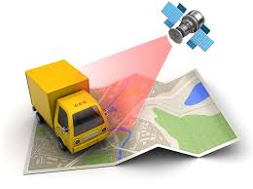

Types of Surveillance
Fixed Observation
Point
Foot – Mobile
Online
Technical
Notes:
Fixed OP – observing from a static position, urban or rural. May use binoculars, cameras with zoom lenses, night scopes, etc.
Foot/ mobile – physically following the movements of person, vehicle, vessel, asset, etc either on foot or by vehicle
Technical – use of technological aids eg trackers to monitor someone/ vehicle. Motion-activated static cameras in fixed point.
Online – reviewing and monitoring online activity, associations, etc.
Also intrusive – listening devices, “bugging” but won’t be used by MMO.

Slide 8
RIPA
Covert surveillance
“If, and only if, it is carried out in a manner that is calculated to ensure the persons who are subject to the surveillance are unaware that it is or may be taking place”
Two types of covert surveillance (both need RIPA authorisation):
- Directed
- Intrusive
Both need RIPA authorisation

Slide 9
RIPA
Directed surveillance
“Covert but not intrusive and is undertaken:
- for the purposes of a specific investigation or operation;
- in such a manner as is likely to result in the obtaining of private information about a person (whether or not one specifically identified for the purposes of the Investigation or operation)
and
- otherwise than by way of an immediate response to events or circumstances the nature of which is such that it would not be reasonably practicable for an authorisation to be sought”
The MMO can APPLY to conduct directed surveillance ✓

Slide 10
RIPA
Intrusive surveillance
“If, and only if, it is covert surveillance that:
- is carried out in relation to anything taking place on any residential premises or in any private vehicle
and
- involves the presence of an individual on the premises or in the vehicle or is carried out by means of a surveillance device”
The MMO cannot conduct intrusive surveillance ✗

Slide 11
RIPA
What is private information?
RIPA Code of Practice para 3.3 states that private information:
“includes any information relating to a person’s private or family life. As a result, private information is capable of including any aspect of a person’s private or personal relationship with others, such as family and professional or business relationships.”
Para 3.6:
“Private information may include personal data, such as names, telephone numbers and address details. Where such information is acquired by means of covert surveillance of a person having a reasonable expectation of privacy, a directed surveillance authorisation is appropriate.

Slide 12
RIPA
Directed or intrusive?
  Tracking device on a car
  Listening device in a hotel reception
  Recording a specific person giving their details to a shop assistant
  Observation post outside a house
  Public waiting area in a Magistrates’ Court
Notes:
If the device is placed on the outside of the vehicle and is used only for the purpose of tracking the location of the vehicle, it is neither directed or intrusive surveillance (although a property interference warrant under the Police Act would probably be required). However, if the device is used to record private information about the people using the car such as their pattern of use of the vehicle it would be directed surveillance if on the outside of the car, intrusive if the device was inside.
Common areas are not residential. Hotel rooms, flats, prison cells etc. are residential
If the purpose is to covertly confirm the identity of the person as part of a criminal investigation, a directed surveillance authorisation would be necessary, as the person has a reasonable expectation that their details are not being recorded.
Depends! If observation post only allows a limited view of the inside of he premises, it is directed surveillance. However, if for example, a zoom lens was being used which gave a view of that is a good as if you were inside the premises, an intrusive surveillance authorisation is necessary.
Intrusive! 2010 order provides that any covert surveillance taking place on premises used for legal consultations shall be treated as intrusive surveillance – includes Mag’s courts, prisons, detention centres, police stations, lawyer’s offices.

Slide 13
RIPA
Collateral intrusion
- There will always be the possibility of some collateral intrusion
- Will information obtained intrude on privacy of an individual not subject to surveillance?
- How will it be minimised?
- Is it acceptable?
- Is it proportionate?
Notes:
When making an application for directed surveillance both the applicant and the authorising officer must take account of any private information that will be obtained about anyone who is not the subject of the surveillance.
Where this possibility exists, consideration must be taken to try and minimise the intrusion of their privacy.
If collateral intrusion is inevitable, it must be considered whether this is proportionate to the aims of the surveillance operation.
e.g. DIS intend to conduct directed surveillance against Keith Owen on the grounds that he is hiding assets that should be recovered to pay a Compensation Order. It is assessed however, that such surveillance will result in obtaining information about his wife and his brother who are not the subjects of the surveillance. The proportinality of this intrusion should be considered – are there ways such as not actually making a record of the surveillance, limit collateral intrusion?

Slide 14
RIPA
Authorisation
Covert directed surveillance with a risk of obtaining private information that is part of an investigation and not an immediate response to events cannot be carried out without prior RIPA authorisation (i.e. MMO MEOs cannot carry out this type of surveillance)
Covert directed surveillance that is not part of a specific operation or investigation cannot be authorised at all (i.e. no public authority can do this)

Slide 15
RIPA
Authorisation
Covert directed surveillance can only be carried out by MMO MEOs if:
- it is an immediate response to events or circumstances which by their very nature could not have been foreseen
or
- there is absolutely no likelihood that any private information about anyone will be obtained (highly unlikely that no private information about anyone will ever be obtained)
If unsure, use Directed Surveillance Flowchart
Approval must be granted before any surveillance is carried out

Slide 16

RIPA
To consider an application under RIPA to carry out surveillance, the activity must be:
Justified
Authorised
Proportionate
Auditable
Necessary
Failure to comply can have serious implications for the MMO

Slide 17
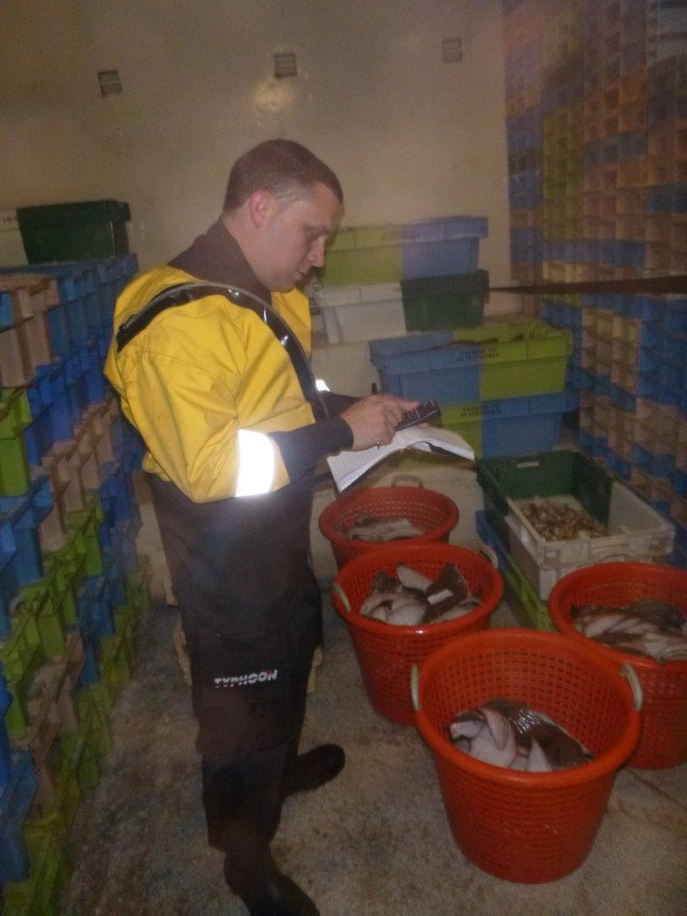
RIPA
When does RIPA not apply?
When surveillance is overt;
When you’re conducting general observations as part of your role;
When you’re using surveillance as an immediate reaction to events;
If you’re unlikely to obtain any private information about a person;
It’s not related to a specific target, MMO core function or investigation;
CCTV and ANPR may be obtained without authorisation.

Slide 18
RIPA
Covert Human Intelligence Sources (CHISs)
“A person who establishes or maintains a personal or other relationship with a person for a covert purpose to obtain information or provide access to information for another person, or discloses information obtained by use of a relationship.”
Authority to use CHISs comes from RIPA 2000, which MMO is listed on the Schedule for as a ‘Relevant Public Authority’, therefore we could use CHIS’.
However, not currently being used due to not having structure and expertise in place

Slide 19
RIPA
Covert Human Intelligence Sources (CHISs)
Whether or not a person is a CHIS depends on length and nature of relationship, tasking and nature of covert activity
Example
Intelligence suggests a local shopkeeper is selling alcohol to under-aged customers. A juvenile is engaged and trained by a public authority and then tasked to attempt a test purchase
Is this juvenile a CHIS? The juvenile is not a CHIS if they are not establishing a relationship with the shopkeeper from a single test purchase

Slide 20
RIPA
Covert Human Intelligence Sources (CHISs)
When is a CHIS not a CHIS?:
- If they are a public volunteer
- If they are working in a professional or statutory capacity
- If no relationships are involved
- If you have not engaged the informant in obtaining information for you
(i.e. if an informant is providing information to you freely without any instruction on your part to do so, they are not a CHIS)
If unsure whether an informant could be deemed to be a CHIS, use the CHIS Flowchart

