Slide 1

Introduction to
Intelligence
November 2021
Classification : Official Sensitive
An introduction to the role intelligence plays in the MMO and IFCAs

Slide 2

Module Aims
To introduce you to intelligence;
Ensure you are comfortable identifying, obtaining and recording information;
Explain the legal basis for gathering and retaining intelligence;
Outline the purpose and uses of intelligence and the role it plays in the wider organisation;
Define the importance of intelligence in effective tasking of resources.

Slide 3
Module Objectives
By the end of the module you will:
  Understand the difference between information and intelligence;
  Understand the importance of information gathering;
  Understand for what reasons we can collect intelligence;
  Understand the role of intelligence in tasking;
  Recognise the products generated by the intel team;
  Understand how you can make a difference
This will ensure…
  Intelligence is collected and retained lawfully and utilised effectively in intelligence-led tasking.

Slide 4
What is Intelligence?
Anything that suggests a criminal offence may be taking place;
Anything which may be a driver for non-compliance;
Does not need to be proven or corroborated;
Does not need to be reliable or detailed;
Can be from an anonymous source;
Can be from one of our own officers or contacts;
Can relate to offences outside of the MMO’s remit.

Slide 5
Examples of Intel
“There’s a JCB doing construction work on the beach”
“I heard gunshots whilst walking my dog on the beach; I think fishermen are shooting seals”
“A white transit van is selling fish to the houses in my street”
“A local fishing boat is using a generator on board to catch razor clams with electricity”
“Drugs are being sold on the fish quay to the crew of the Boy Blue”
“Undersized lobsters are being landed in Amble on weekends”
“Foreign crew are working illegally on scallopers from Brixham”
“The skipper of the Morning Star in Fleetwood is aggressive towards fishery officers”
“Bass is being transhipped between small boats that land into Harwich late at night”
“Bluefin tuna is being targeted by charter fishing boats from Looe”

Slide 6
How do we use intel?
Direct enforcement activity;
Ensure coastal and operational teams are sent to areas where there’s the greatest risk of non-compliance, according to intelligence.
Justify allocation of resources;
Intelligence provides justification as to why resources have been allocated to these areas and demonstrates that we’re taking action where information indicating non-compliance is received.
Identify emerging issues, seasonal trends and increased risk;
The volume and reliability of intelligence is assessed and this indicates where the risk of non-compliance lies, how this compares to other risks and determines any risk that recurs annually to allow us to put mitigation measures in place.
Guide lines of enquiry in an investigation;
Additional offences or associated suspects may be identified through intelligence.
Lawfully share information on suspects with other law enforcement agencies.
A standardised format is used for intelligence handling, which allows us to exchange with police and other agencies.

Slide 7
Retention of Intelligence
Policing Purpose
We can only legally retain intelligence where we have justification under law enforcement purposes for doing so. Policing purposes provide the legal basis for the collection, recording, evaluation, sharing and retention of information and may include one, or a combination, of the following:
protecting life and property
preserving order
preventing the commission of offences
bringing offenders to justice
any duty or responsibility arising from common or statute law.
In order to allow lawful sharing of intel – there must be a policing purpose, protocols in place and a legitimate need to share it.

Slide 8
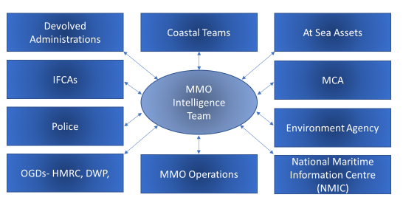
Who does the MMO Intel Team engage with?

Slide 9
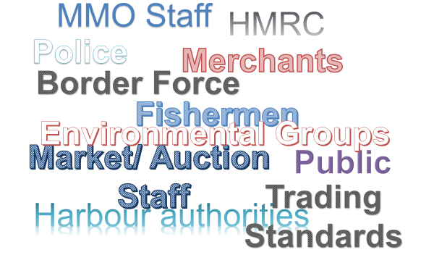
Sources of Intel – Where does Intel come from?

Slide 10
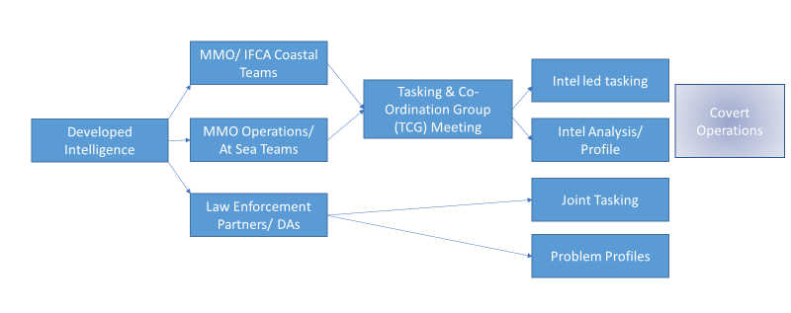
The MMO & IFCA Intelligence Process

Slide 11
Information vs Intelligence
What is the difference between information and intelligence?
‘Intelligence is information that has been evaluated and risk assessed (3x5x2) to assist with the decision making process’
(National Intelligence Model definition)
Information becomes intelligence when it is assessed, evaluated and developed.
Information is sanitised to remove any information that reveals the source (who provided the information). We have a duty to protect the source of any intelligence that we act on, to ensure they can’t be identified and therefore are not placed at risk due to having provided us with information.

Slide 12
Sanitisation
“Reports should be sanitised for onward transmission by removing material which explicitly or implicitly identifies a source or sensitive law enforcement methodology.”
Unsanitised Information
“Chris BROWN told me that Billy SMITH is landing sole that isn’t recorded on his logbook on Thursday evenings, after 9pm”
REFERENCE TO CHRIS BROWN, AS THE SOURCE OF THE INFORMATION, IS REMOVED. THIS IS TO PREVENT HIM BEING IDENTIFIED AS HAVING PROVIDED INFORMATION, AS THIS COULD PLACE HIM AT RISK
Sanitised Intelligence
“Billy SMITH is landing unrecorded sole after 21:00 on Thursdays”
REMOVE THE SOURCE, KEEP IT BRIEF, KEEP IT FACTUAL.

Slide 13
The Tasking & Co-Ordination Group
  Held monthly;
  Attended by PMOs, SMOs, IFCA chief officers or deputies, MMO & IFCA intelligence leads, intel team representative, ops team intel lead;
  Intelligence received throughout the month is reviewed ahead of the meeting by the local intelligence lead (MEO/IFCO with responsibility for intelligence) and the designated intelligence officer;
  Intel is collated and emerging risks/ trends are identified;
  During the TCG:
    Ongoing taskings are reviewed;
    New intelligence and trends/ risks are considered;
    Taskings are agreed upon, to allow the intelligence to be acted upon by coastal/ ops officers.

Slide 14
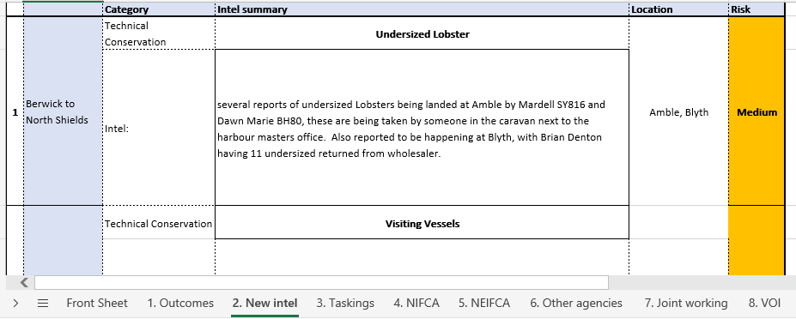
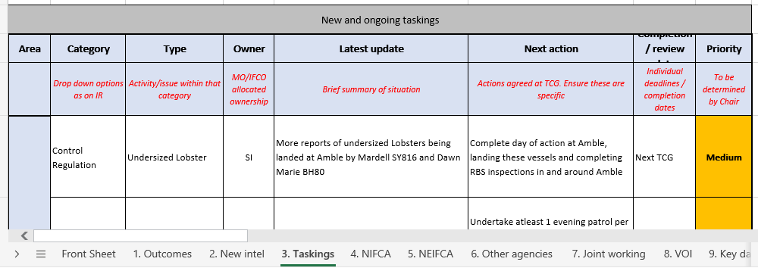
The Tasking & Co-Ordination Group
Intelligence is reviewed and summarised by topic.
Taskings are discussed and agreed upon, in order to act on the intelligence.

Slide 15
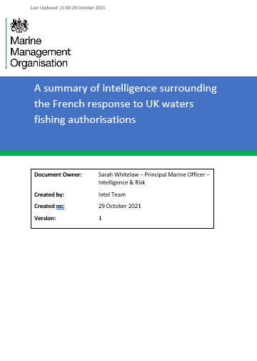
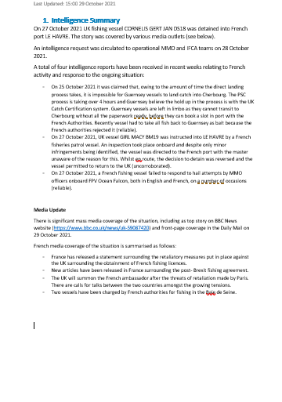
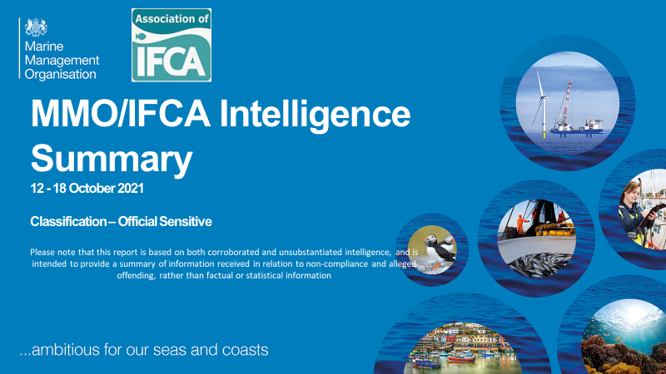
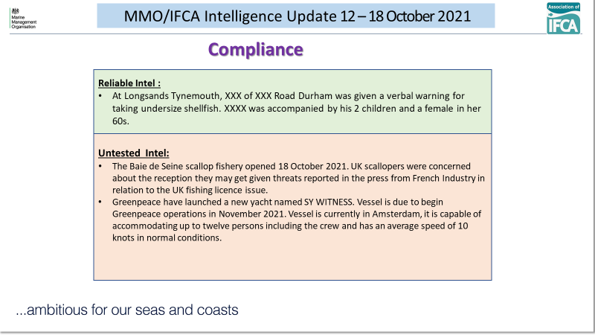
Intelligence Team Products – Summaries & SitReps
Notes:
Situation reports (sitreps) or summaries may be created in relation to emerging issues, in order to keep all informed as situations progress and develop. Weekly summaries are circulated to MMO and IFCA staff, summarising the intel received/ processed each week.

Slide 16
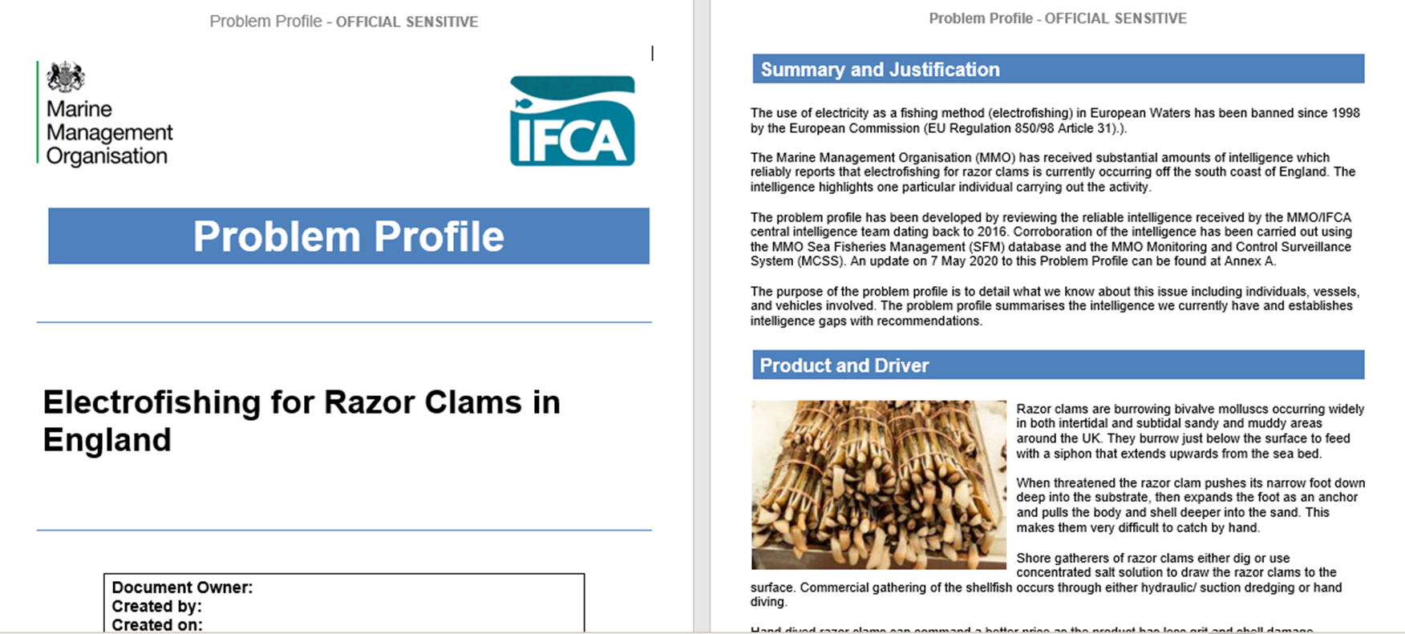
Intelligence Team Products – Problem Profiles
Problem Profiles
Generally focus on new or emerging issues;
Collate, summarise and analyse intelligence;
Identify intelligence gaps;
Generate tasking and enforcement action;
Can be requested by ops or coastal teams;
May incorporate input from partner agencies.

Slide 17

What can you do?
Retain details of intelligence you encounter- keep notes in your notebook, take photos where appropriate;
Report intelligence to the intel team via the Intel Homepage: https://defra.sharepoint.com/teams/Team1332/
Complete the Intel Reports training module.

Slide 18

Contact the intelligence team:
intel@marinemanagement.org.uk
Sarah Whitelaw – Principal Marine Officer: Intelligence & Risk
Jo Atkinson – Intelligence & Risk Analyst
Intelligence Officers:
Alex Dakers
Andrew Venton
Anna Watson
Donald Nimmo
Faye Kent

