Slide 1


Searches

Slide 2
Searches
Introduction
Any entry into, search of, or seizure from a private location is an interference with a person’s right to respect for private and family life
(Article 8 Human Rights Act 1998)
Therefore, any search of private premises must follow relevant legal provisions and be proportionate response to matter under investigation
Private premises includes business premises, vessels, vehicles and……

Slide 3
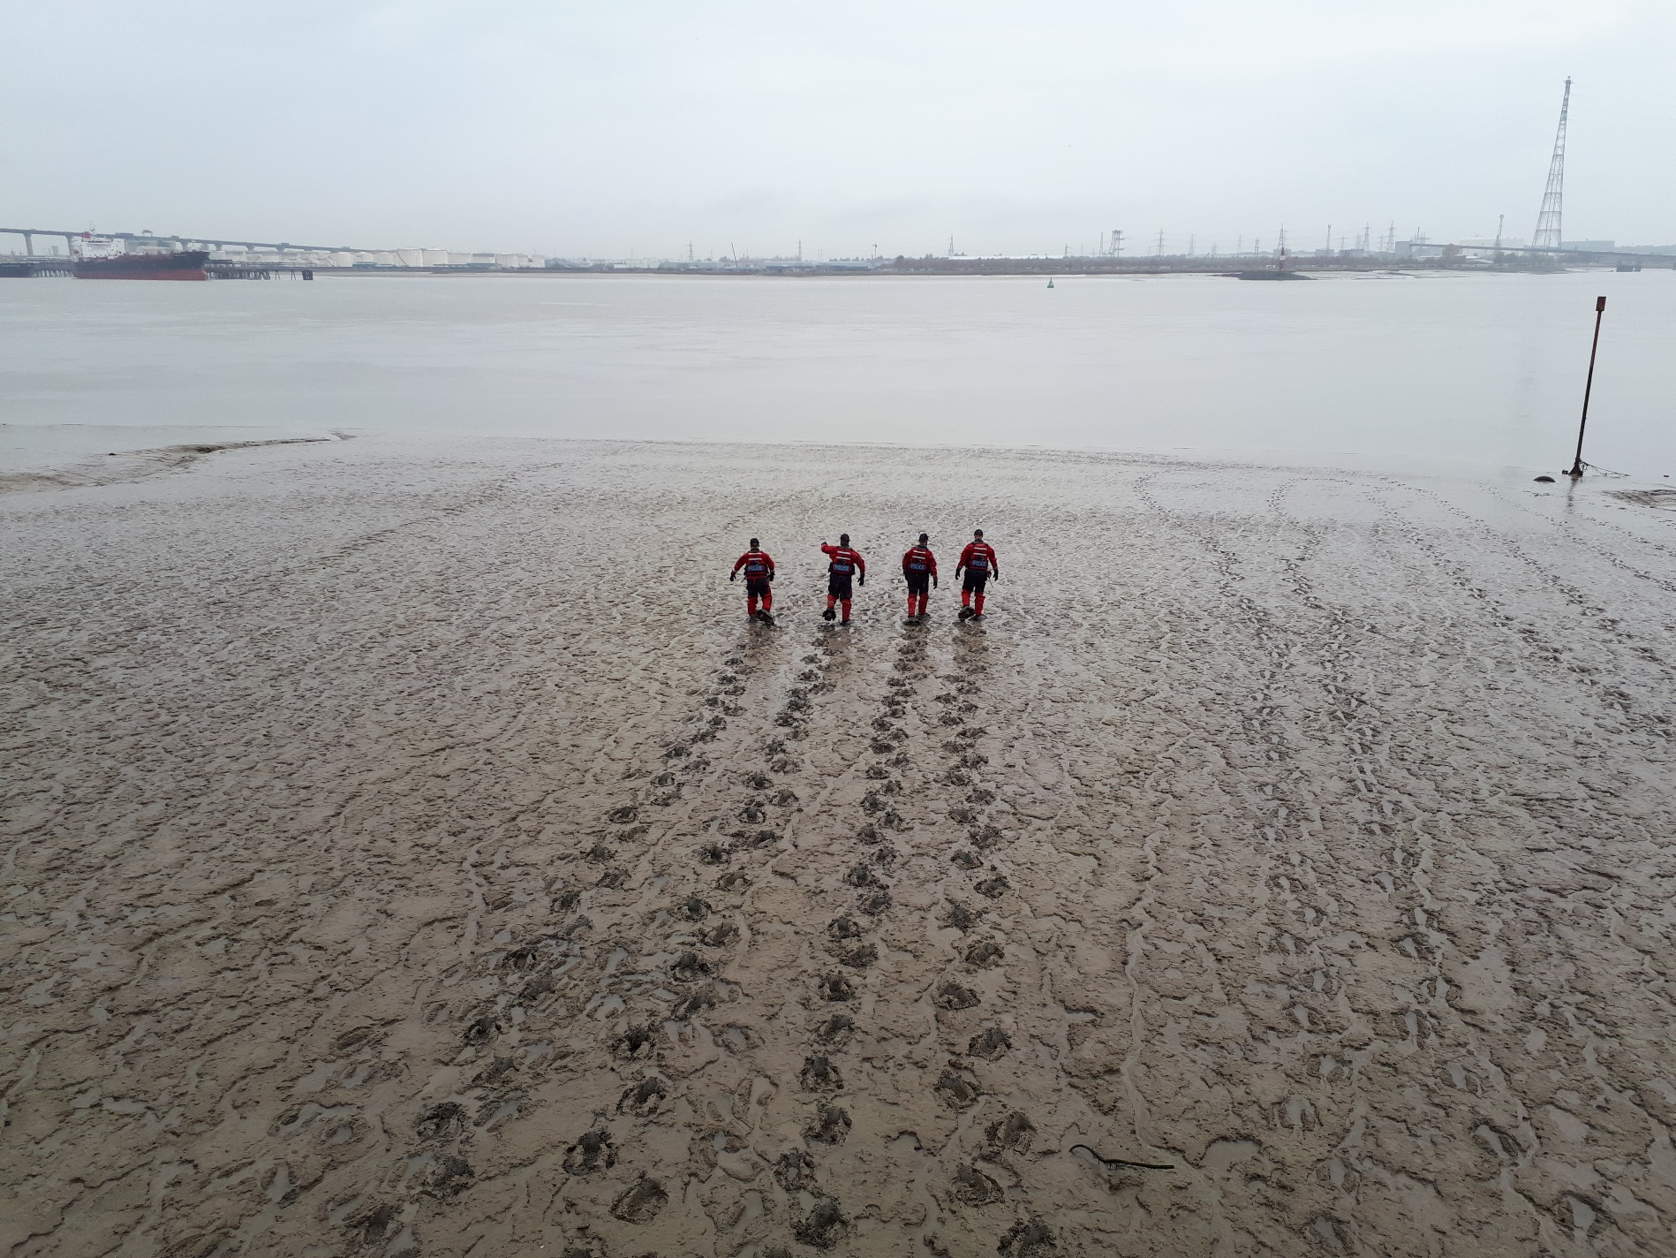
……land!

Slide 4
Searches
Powers
Powers to search are derived from Common Enforcement Powers in MACAA (apply to both MEOs and IFCOs)
Fairly wide-ranging powers in relation to searching
Nine MACAA Sections relating to MEO / IFCO powers when searching (247, 249-254, 260 and 261)

Slide 5
Searches
Section 247 – Power to enter and inspect premises
Can enter and inspect any premises for purposes of carrying out relevant functions
Must do so at a reasonable time, unless you suspect doing so would frustrate entry
Can require any person on premises to facilitate exercising of this power

Slide 6
Searches
Section 249 – Dwellings
Can NOT enter a dwelling without a warrant
Justice can only issue warrant if they are satisfied that:
- you have reasonable grounds for believing there is material at the dwelling which, for the purposes of carrying out your relevant functions, you wish to inspect, examine or seize
- not practicable to contact anyone to gain entry
- entry is not likely to be granted without a warrant
- that the purpose of entry may be frustrated

Slide 7
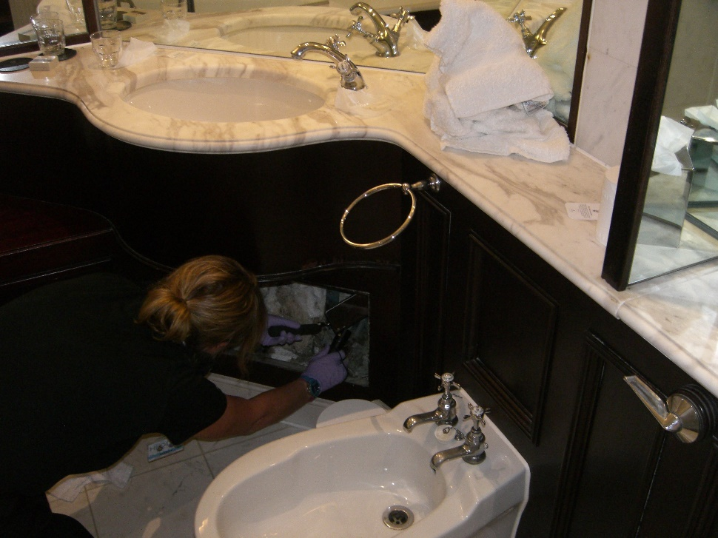
Searches
Section 250 – Power of search and examination
Can search the premises for any item
Can examine any item on the premises
Can stop and detain any person and search for or examine anything in their possession
Can break open
any container or
locked thing on the
premises

Slide 8
Searches
Section 251 – Power to require production of documents
Can require any person on premises to produce any document or record in their possession or control
Section 252 – Powers of seizure
Can seize and detain or remove any item found on premises
(apart from anything subject to legal privilege)
Can take copies of or extracts from any documents found on premises
Can seize and detain or remove any item found in person’s possession or control

Slide 9
Searches
Seize and Sift
MACAA provides powers of seize and sift that were not afforded to officers previously
Allows MEOs / IFCOs to take large quantities of potential relevant material to sift through at a later date when not practicable to do so on premises
Irrelevant material found using these powers should be returned as soon as possible

Slide 10
Searches
Section 253 – Further provision about seizure
Can seize container in which item(s) found, if it facilitates seizure
Can secure an item if not practicable to be removed at time
Section 254 – Retention of seized items
Can retain item for as long as necessary, unless a photograph or copy would suffice

Slide 11
Searches
Section 260 – Assistance
Can bring any other person to help carry out relevant functions, who can then exercise MEO powers under your supervision
Can bring any equipment or materials to help carry out relevant functions
Section 261 – Power to use reasonable force
Can use reasonable force if necessary to exercise any MEO / IFCO powers (as can any person assisting you)

Slide 12
Searches
Warrants – Schedule 17
Schedule 17 of MACAA provides requirements for serving of warrants for dwellings issued under s.249
Entry to a dwelling without a warrant is unlawful
Code B Notices
Notice of MEO / IFCO powers and occupiers’ rights
Issued for all searches, not just when exercising a warrant
Search Register
Central search registered is required.

Slide 13
Searches
Warrants – Case Law
“Generations of justices have… been brought up to recognise that the issue of a search warrant is a very serious interference with the liberty of a subject, and a step that should only be taken after the most mature careful consideration of all the facts of the case…”
Lord Widgery CJ in Williams v Summerfield [1972]
“The obtaining of a search warrant is never to be treated as a formality. It authorises the invasion of a person’s home.”
R (Redknapp) v City of London Police [2009]

Slide 14
Searches
Execution of pre-planned searches
One MEO / IFCO should be designated Lead
Another person (preferably Exhibits Officer) to take responsibility for Search Book
Lead Officer to inform occupants of search, the process and provide copy of Code B Notice and warrant (if dwelling)
Good practice to photograph/video each room
Record any existing damage

Slide 15
Searches
Execution
- record all persons on premises
- sketch plan of each room in premises
- complete scene notes (significant incidents, comings and goings)
- record all exhibits seized

Slide 16
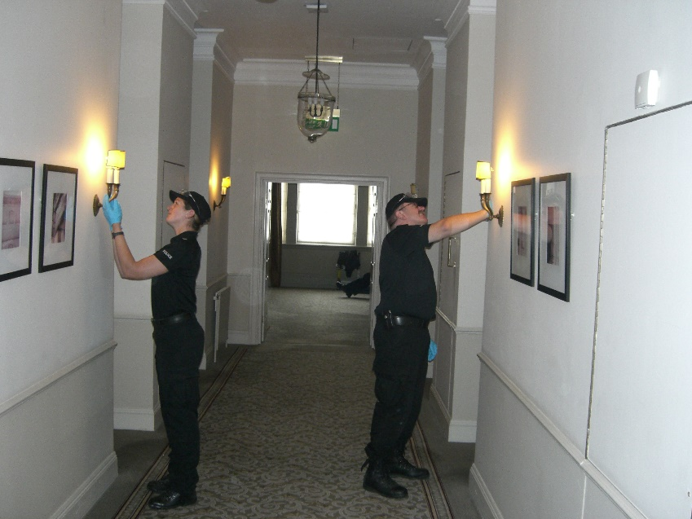
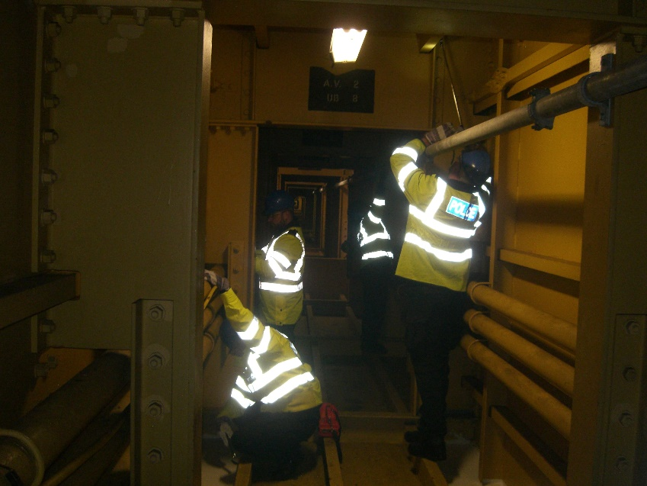
Other officers to carry out searches
Officers searching should be methodical, start at one end of the room and work round
Recommended two officers search a room together, one working clockwise, the other anti-clockwise, crossing over

Slide 17
Searches
Execution
Fully describe the location of finds so officer completing Search Book can record where in the room evidence was seized from
All seized evidence to be brought to Lead Officer for assessment and then to officer completing Search Book
Occupant to be provided with receipt for every item seized

Slide 20
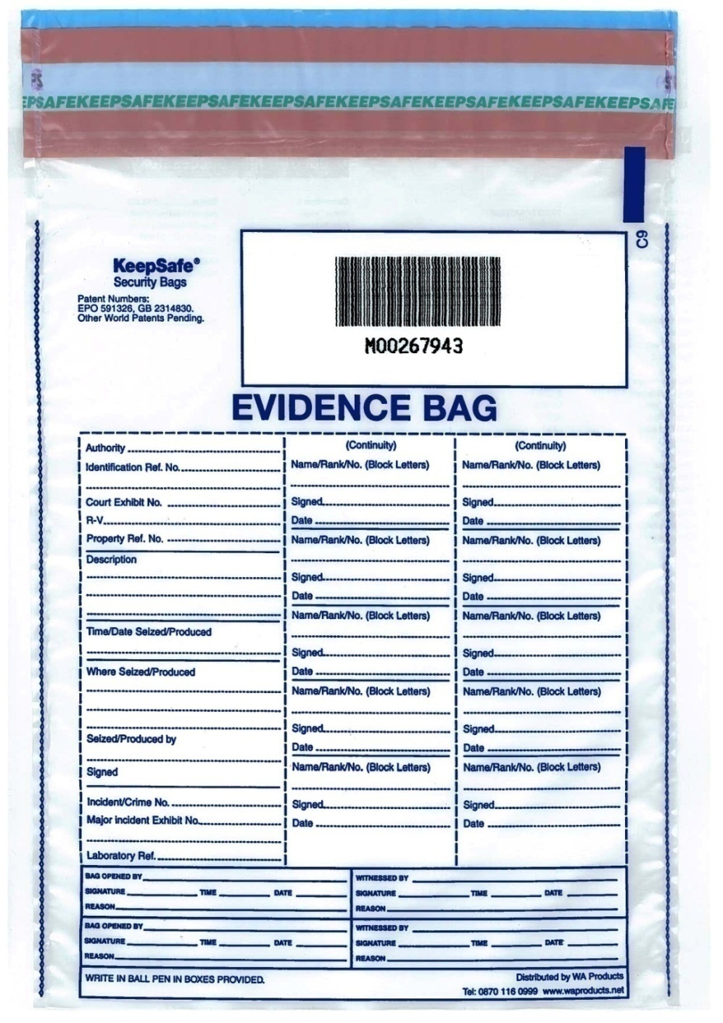
Searches
Seizing material
Seized materials should be bagged securely and logged in Search Book
Complete evidence bag before putting evidence in
Continuity of evidence is paramount to an investigation; strict procedures must be adhered to

Slide 21
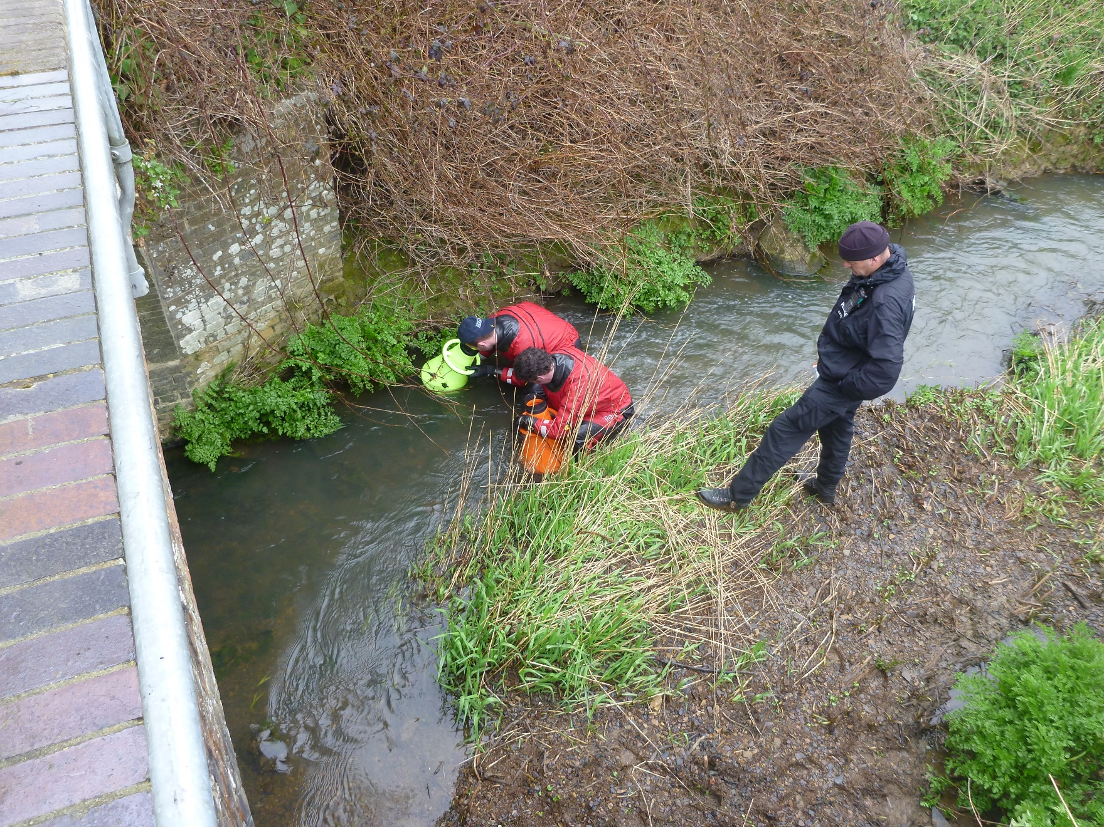

Slide 22
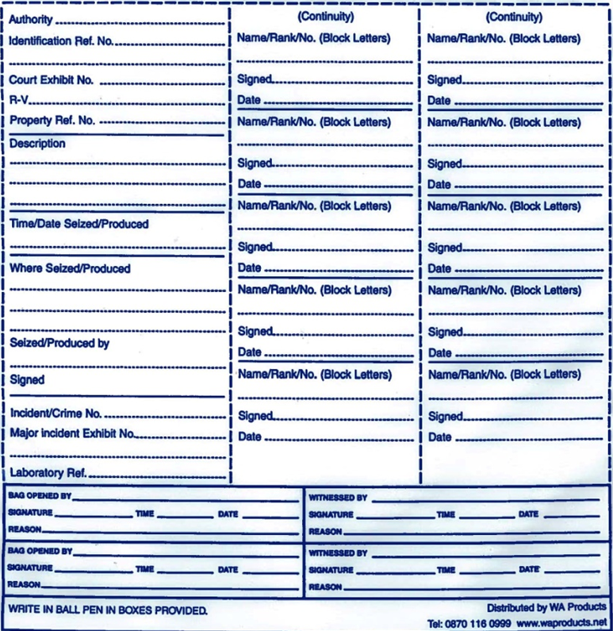
Searches
MMO
Exhibit ref (e.g. MJT001)
e.g. 2015 diary with blue cover
Time and date seized
Location where seized
Officer who seized it
Officer’s signature
PFV number
To be completed whenever opened (the evidence and
original evidence bag must
then be sealed in a new
evidence bag)
Needs to be witnessed

