Slide 1
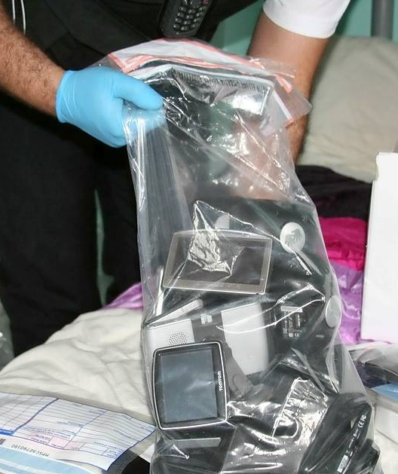


Evidence Handling

Slide 2
Exhibit Handling
What is an exhibit?
A material object or document produced and identified in court or before an examiner for use as evidence
Duty of those investigating to retain for use in court anything which may be evidence of a crime and which has come into the possession of the investigation.

Slide 3
Exhibit Handling
Your responsibility
As a general rule the court entrusts the prosecution with exhibits pending trial
Prosecution’s duty is to:
- take all proper care to preserve the exhibits safe from loss or damage
- cooperate with the defence in order to allow them reasonable access to exhibits for the purpose of inspection and examination
- produce relevant exhibits at the trial

Slide 4
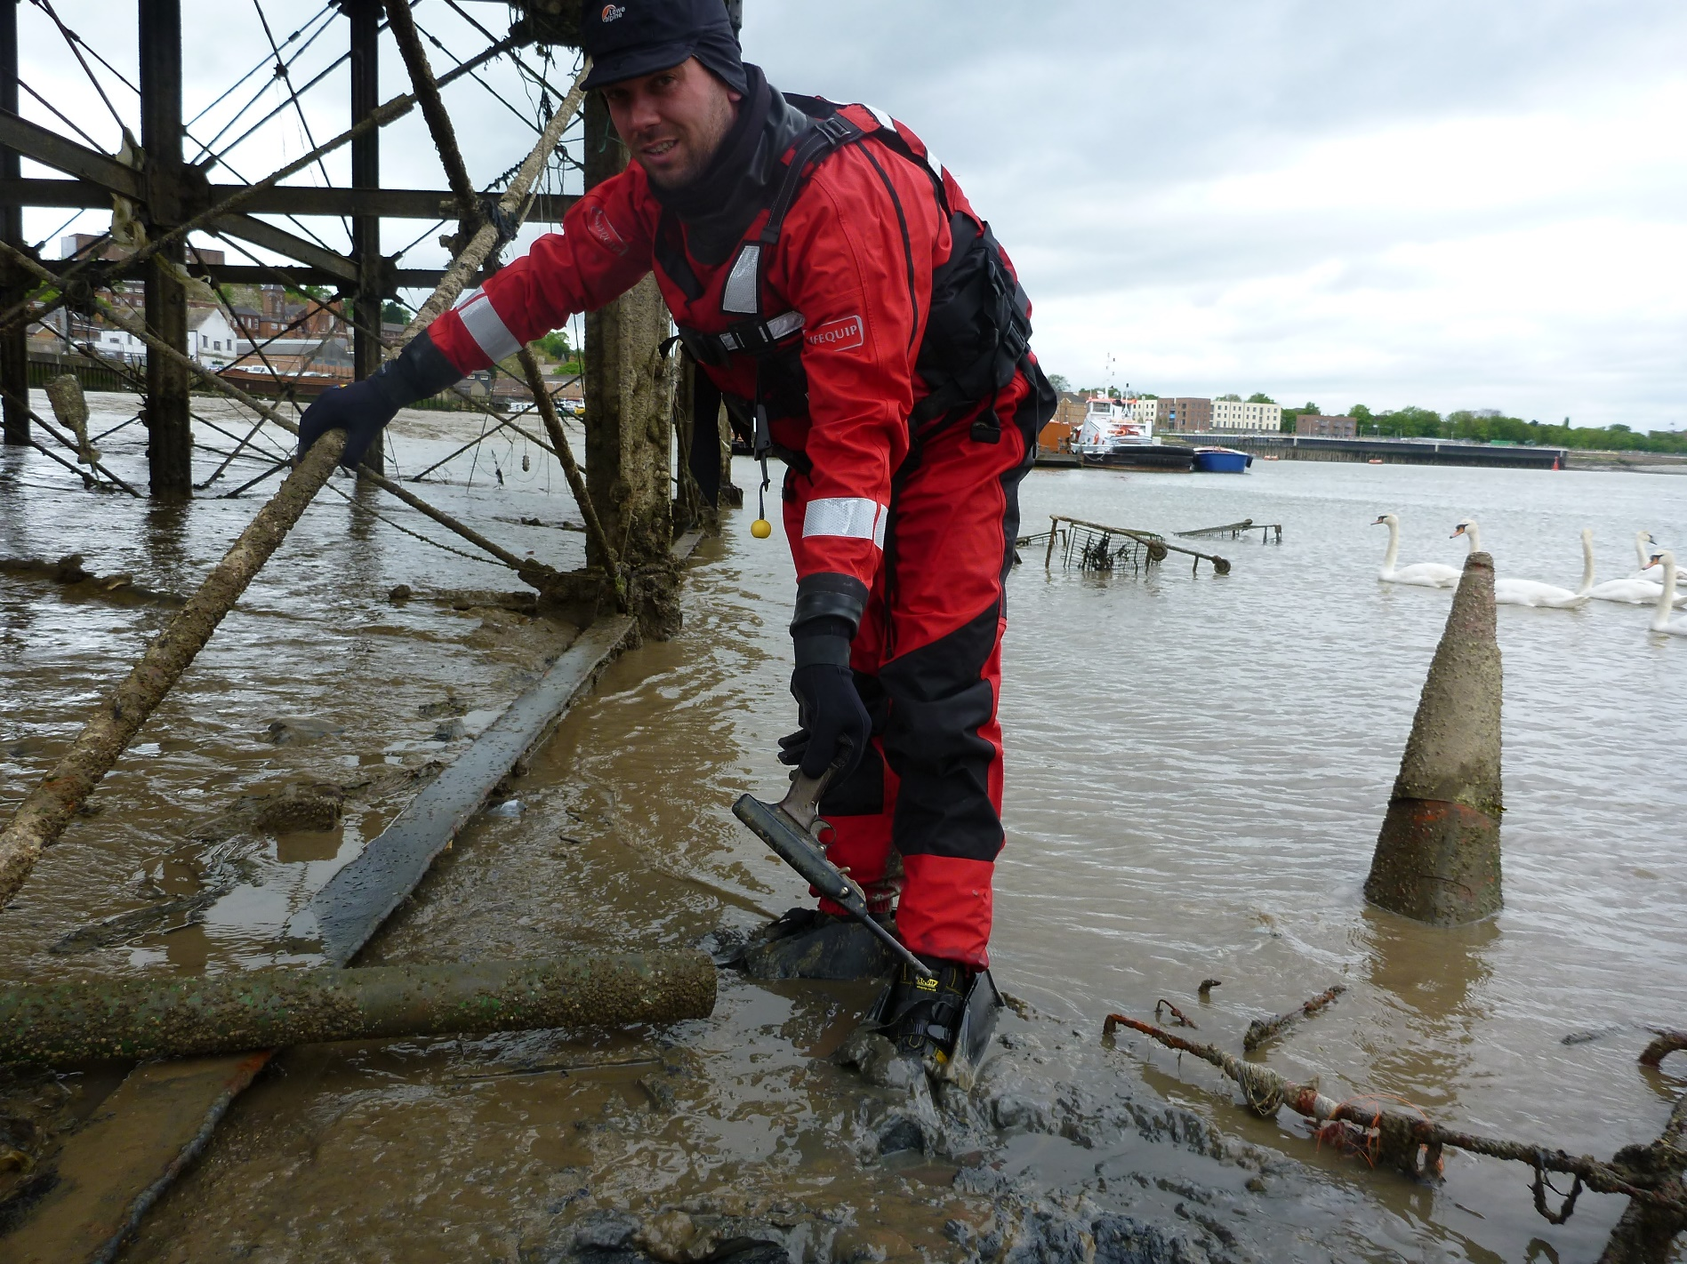

Slide 5
Exhibit Handling
Exhibit referencing
Relevant material should be given an exhibit number as soon as practicably possible by the person whose possession it came into
Exhibit numbering should be person’s full initials followed by numbers in sequential order-
DCL001
Ensure nobody else likely to produce exhibits as part of same investigation has same initials

Slide 6
Exhibit Handling
Sources of exhibits
Seized from a premises or potential offender
Produced from databases or records
Created by the investigator or third party

Slide 7
Exhibit Handling
Seized exhibits
Should be put in an evidence bag
A receipt should be given to the appropriate person
A code B notice should be provided (searches only)
If using power of seize and sift a CJPA section 52 notice should be provided as well.
Put into secure storage on return to the office

Slide 8
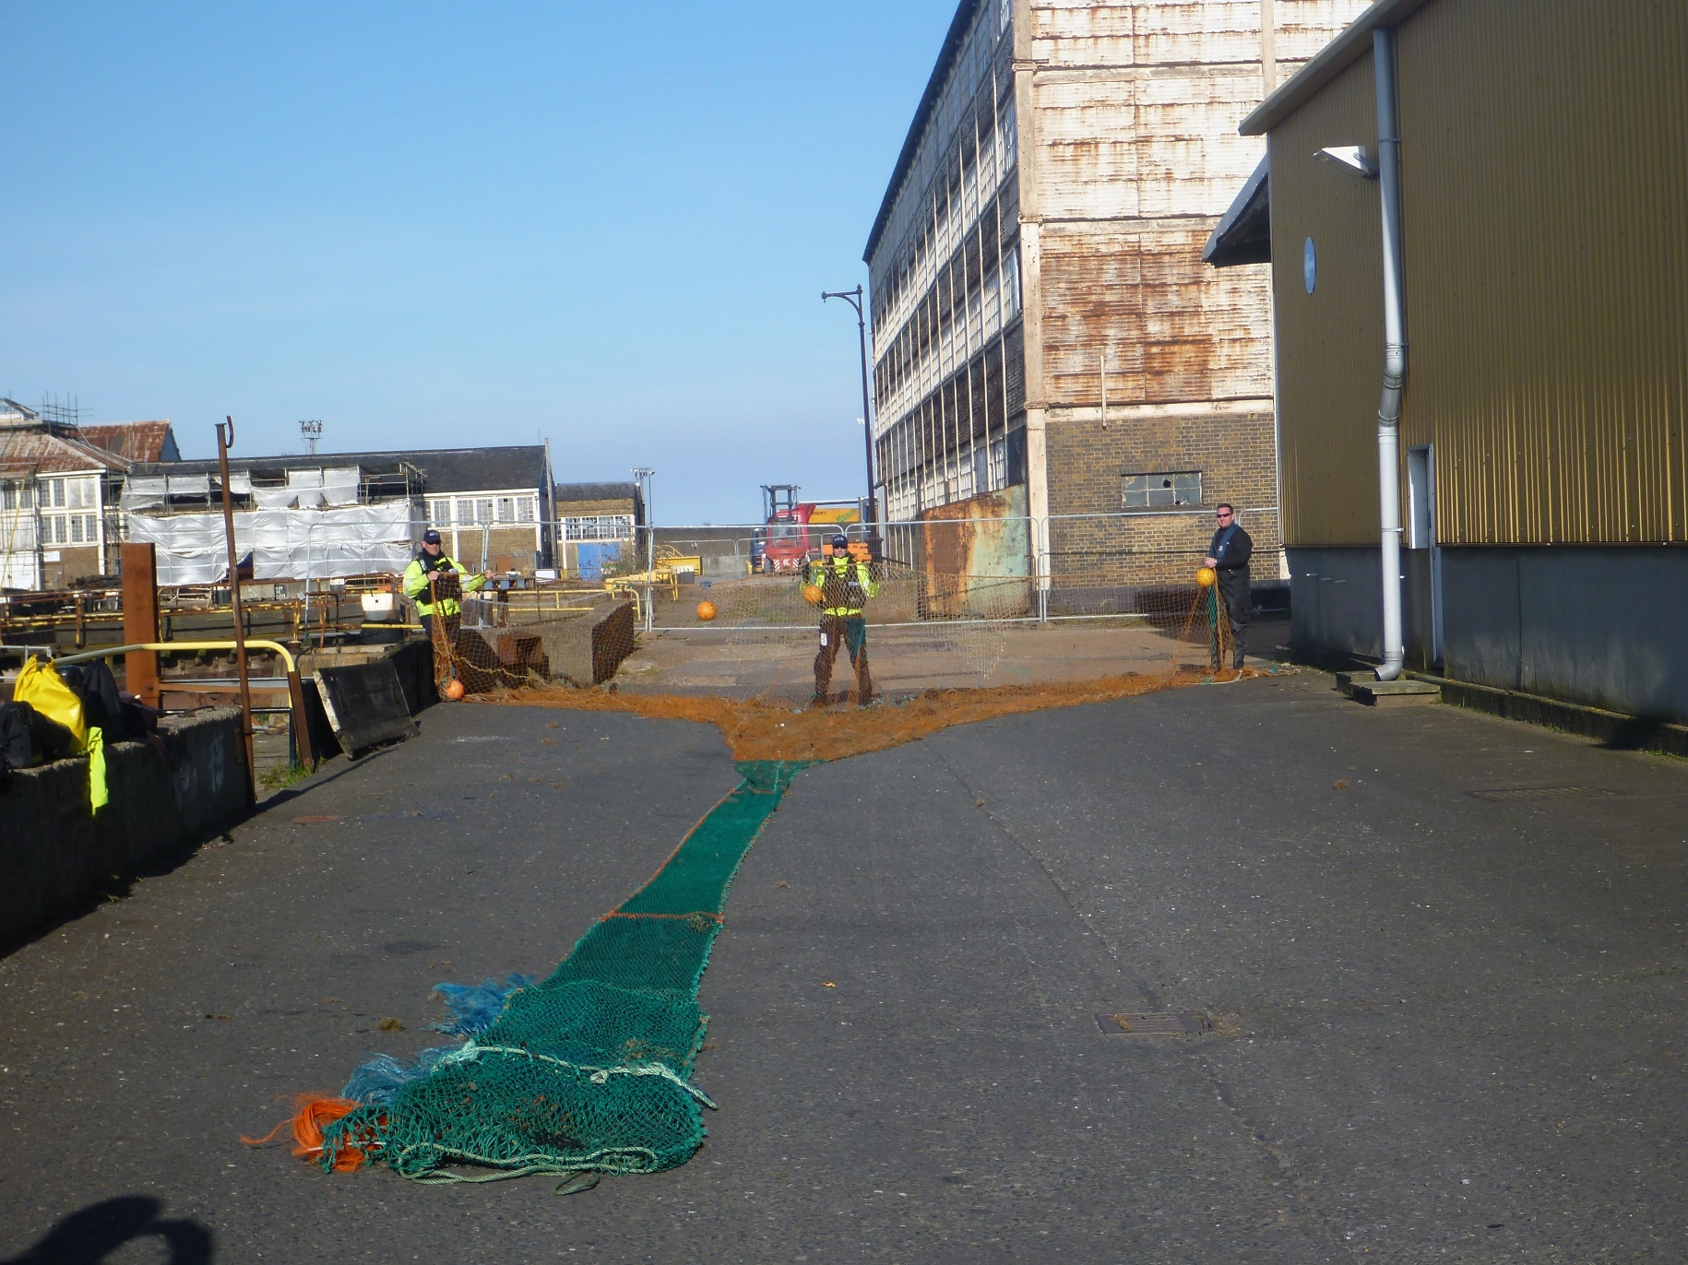
Exhibit Handling
What do you do with this?

Slide 9
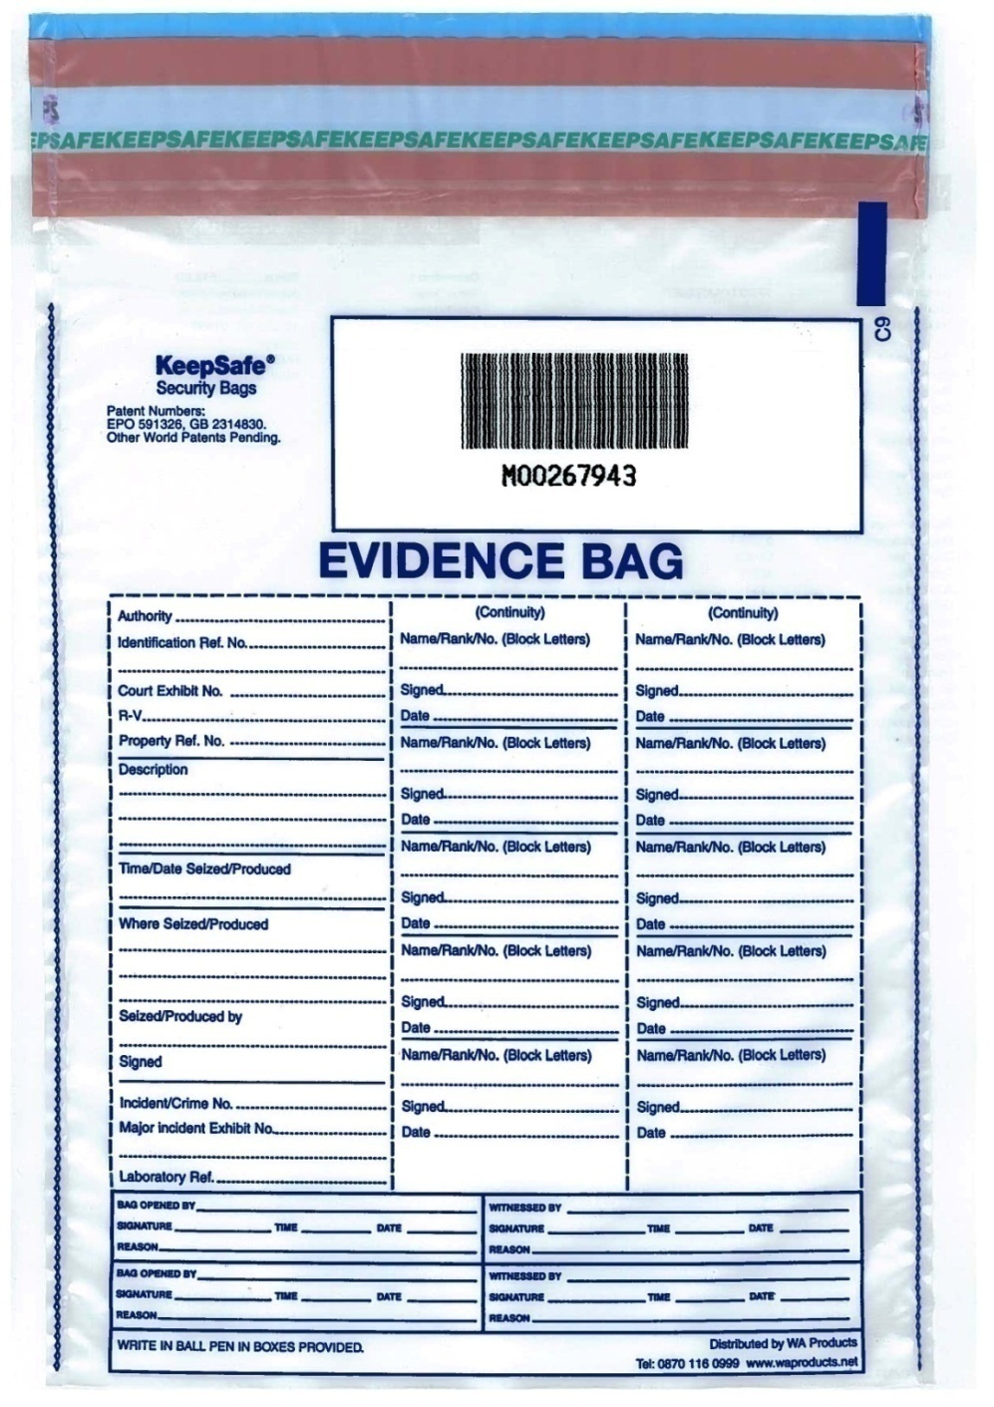
Exhibit Handling
Seizing material
Seized materials should be bagged securely and details noted in PNB
Complete evidence bag before placing items in
Continuity of evidence is paramount to an investigation; strict procedures must be adhered to

Slide 11
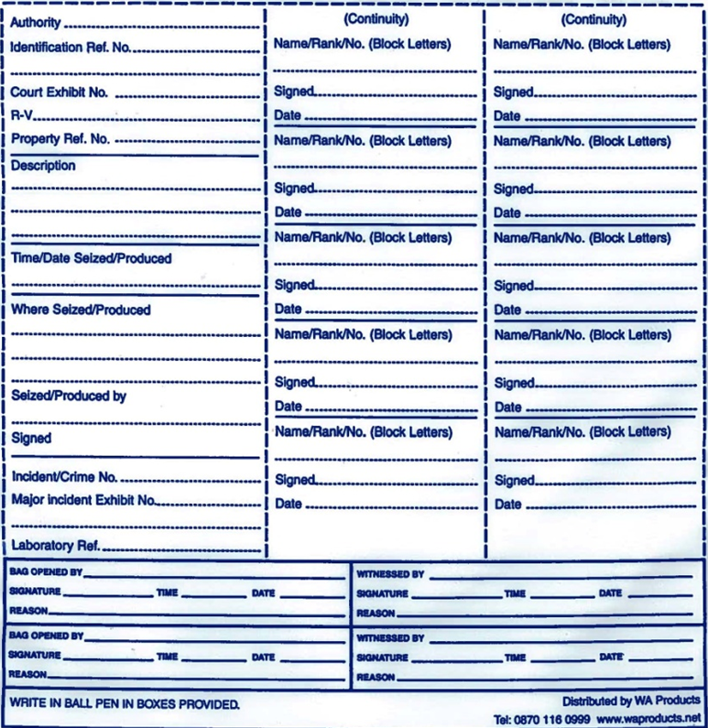
Exhibit Handling
MMO
Exhibit ref (e.g. MJT001)
e.g. 2015 diary with blue cover
Time and date seized
Location where seized
Officer who seized it
Officer’s signature
PFV number
To be completed whenever opened (the evidence and
original evidence bag must
then be sealed in a new
evidence bag)
Needs to be witnessed

Slide 12
Exhibit Handling
Produced exhibits
Should be printed out by the person producing the exhibit
They should create a label
These should be handed over to the investigations team
They should be handed to the exhibits officer, logged and put into secure storage.

Slide 13
Exhibit Handling
Created by investigator exhibits
You may produce explanatory diagrams or tables
You should print them out
Make a label
Hand to the exhibits officer and get them logged into secure storage.

Slide 14
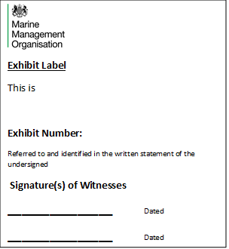
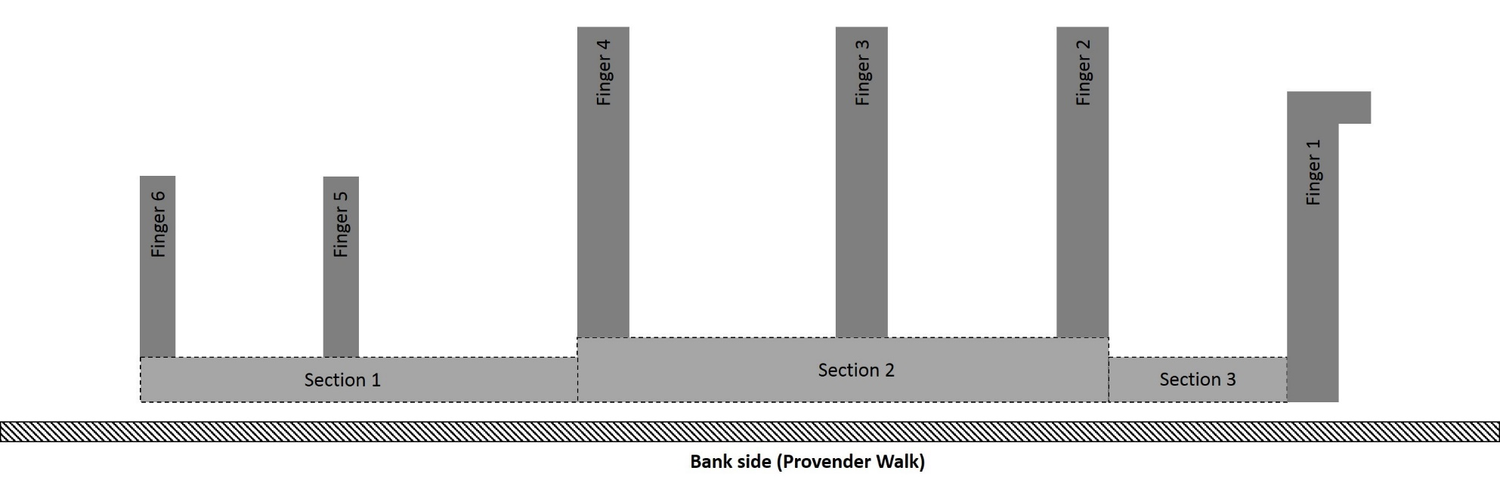
Court Exhibit No.
Unique label | Length (meters) | Width (meters) | Area (m²) (length x width)
Section 1 | 13.5 | 1.4 | 18.9
Section 2 | 16.4 | 2 | 32.8
Section 3 | 5.5 | 1.4 | 7.7
Finger 1 | 9.6 | 1.6 | 15.36
Finger 1 (side section) | 1 | 1 | 1
Finger 2 | 7.6 | 1 | 7.6
Finger 3 | 7.6 | 1 | 7.6
Finger 4 | 7.6 | 1 | 7.6
Finger 5 | 5.6 | 1.1 | 6.16
Finger 6 | 5.6 | 1.1 | 6.16

Slide 15
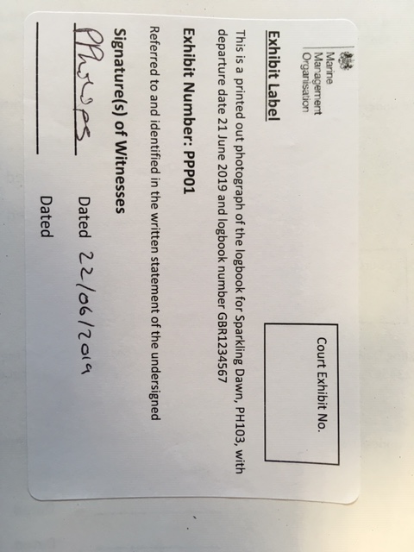
Exhibit Handling
Exhibit labels
Leave blank
Description matches statement
Exhibit number
Date the label is made
Signature of whose statement it is produced in.
Additional signature when exhibit received by another officer
Date exhibit received.

Slide 16
CONTINUITY

Slide 17
Exhibit Handling
Exhibit log
Created and maintained by Exhibits Officer for every investigation
- Location
- Description
- Where seized / received
- When seized / received
- Who seized / received
- Movements
(e.g. sent for external forensic analysis)

Slide 18
Exhibit Handling
Storing exhibits
Should be kept in a sealed exhibit bag in secure storage with restricted access maintained by Exhibits Officer
When seized, should be sealed in bag preferably in front of owner
If opening, should be witnessed by another officer and then exhibit and original bag should be sealed in another exhibit bag which must be relabelled
Use of originals should be kept to minimum; use working copies when practicable

Slide 19
Exhibit Handling
Use of exhibits
Potential evidence given an exhibit number does not have to be produced in a witness statement
Only exhibits that the prosecution intend to rely upon as evidence need to be produced
Relevant material with exhibit numbers that are not used should be detailed in either:
- Schedule of non-sensitive unused material (MG6C)
- Schedule of sensitive material (MG6D)

Slide 20
Exhibit Handling
Inspection by defence
Requests by defence to inspect exhibits should be ordinarily granted
Make arrangements with defence to facilitate inspection within reasonable timeframe
You are still in control of exhibit, do not leave with defence
Speak to MMO Legal if unsure

