Slide 1
LEGISLATION Introduction

Slide 2
What Legislation applies to us?
Prior to the exit of the UK from the EU in January 2021, the UK was governed by European Legislation as well as our own domestic legislation.
Examples of EU Legislation:
- Human Rights
- Working Time
- Common Fisheries Policy
Since January 2021, the majority of EU regulations have been “Retained” into UK Law. Under the European Union (Withdrawal) Act 2018, through the Fisheries Act 2020, amendments have been made to some EU retained regulations to make them applicable to the UK.
For example:
Common Fisheries Policy: Article 5 allowed equal access to waters in Union Waters. This has been revoked by the Fisheries Act 2020 in the UK retained version of the Common Fisheries Policy.

Slide 3
How to find legislation
All UK and retained EU law is available on https://www.legislation.gov.uk/.
However, this contains all legislation, most of which is not all relevant to us.
The “Blue Book” contains all the relevant fisheries and marine environmental legislation for MEO’s to enforce.
It is divided into ten sections:
Section AA: Statutory Instruments amending Retained EU legislation
Section A: Principal acts relating to sea fishing
Section B: Access to British fishery limits
Section C: Legislation applicable in Welsh and Northern Irish zones
Section D: Illegal, unreported and unregulated (IUU) legislation
Section E: Technical measures for the conservation of fisheries resources
Section F: Total allowable catch (TAC) and quota regulations
Section G: Deep water and highly migratory species regulations
Section H: Control measures
Section I: Licensing regulations
Section J: Marine environmental protection and habitats regulation
Section K: UK-EU trade and cooperation agreement

Slide 4
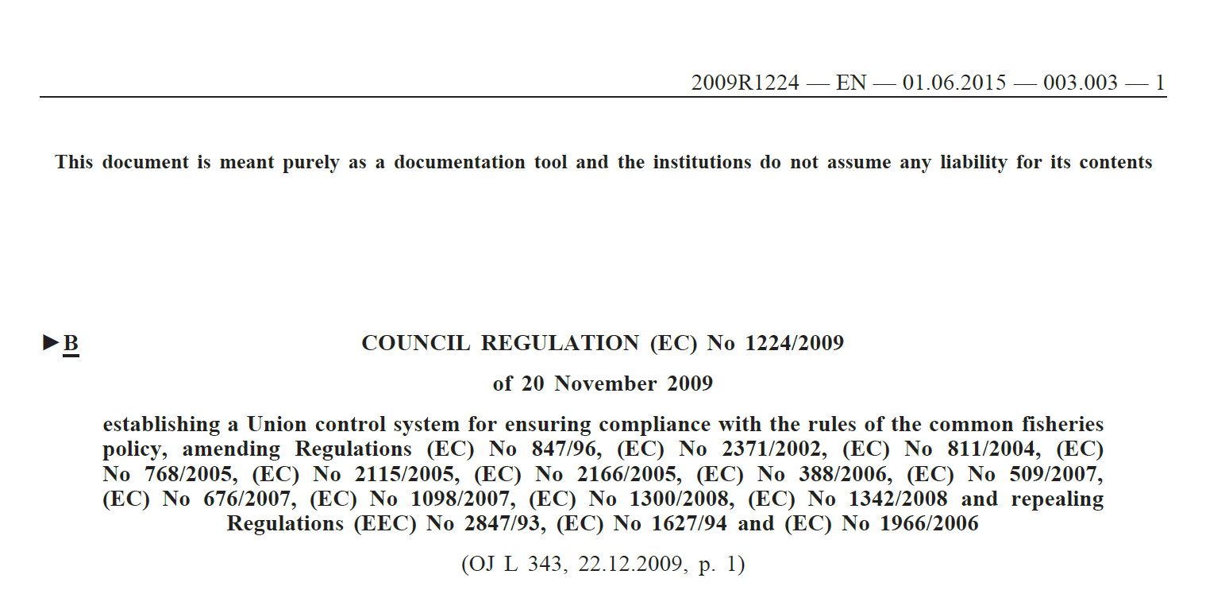
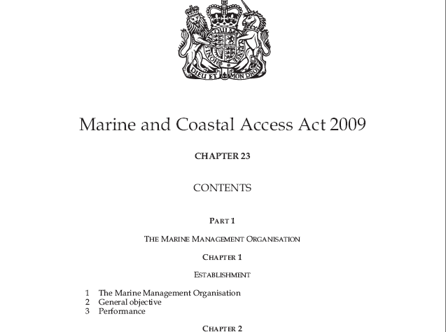
Primary Legislation
All laws come from either Primary or Secondary Legislation
Primary Legislation is created by UK Parliament or EU Ministers
Primary EU Legislation:
EU Council Regulations or Directives
e.g. Control Regulations 2009
Primary UK Legislation:
- UK Acts
e.g. the Marine and Coastal Access Act 2009:

Slide 5
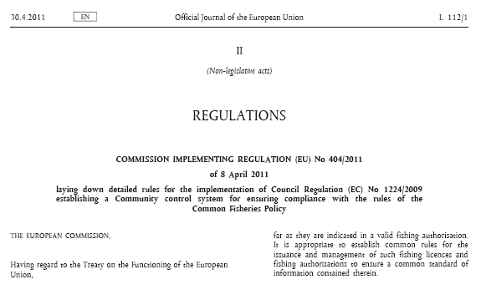
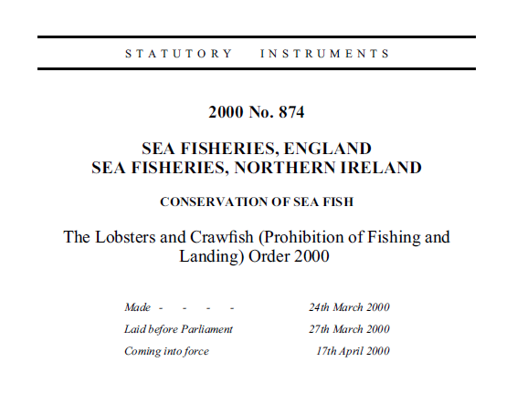
Secondary Legislation
Implements Primary Legislation
Outlines more specific restrictions, offences and penalties
Secondary EU Legislation:
EU Commission Regulations
e.g. Control Regulations detailed rules 2011:
Secondary UK Legislation:
UK Orders (or Statutory Instruments (SI’s))
e.g. The Lobsters and Crawfish Order 2000:

Slide 6
EU
UK
Council
Regulations
Parliamentary
Acts
Primary Legislation
Commission
Regulations
Orders / SIs
Secondary Legislation

Slide 7
Offence Example – Landing of a berried lobster (carrying eggs)
Sea Fish (Conservation) Act 1967
Outlines powers for an ‘appropriate National Authority to make an order’
Primary UK Legislation
The Lobsters and Crawfish (Prohibition of Fishing
and Landing) Order 2000
The order prohibits fishing for, and landing of a berried lobster or a berried crawfish by relevant British or Scottish fishing boat
Secondary UK Legislation

