Slide 1

PIVOT TABLE TRAINING
Please run this as a slideshow (it will play automatically)…

Slide 2
PART 1 – HOW TO CREATE PIVOT TABLES…

Slide 3
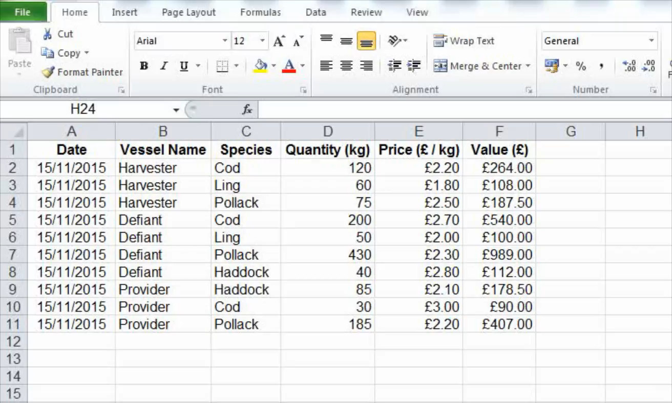
Click here to replay the video, or here to move onto part 2
Note – if you using Excel 2007 or above, the layout will look different. You will need to drag the fields into the boxes below on the right hand pane
The Defiant is actually the highest here!
Alternatively, switch Excel to display ‘Classic’ layout too display as shown here (see course home page for instructions)
Please note - Reference to previous tutorial is no longer relevant

Slide 4
PART 2 – MORE ADVANCED FEATURES OF PIVOT TABLES

Slide 5
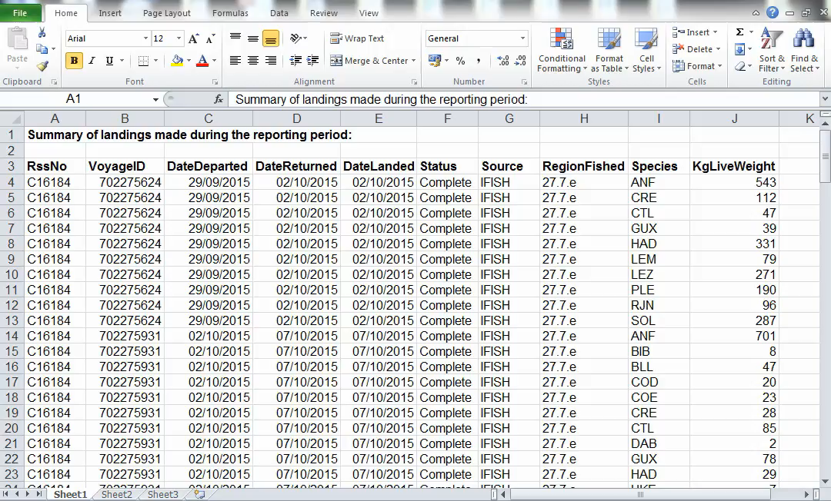
This is the end of the tutorial.
Click here to replay the video, or alternatively please exit and have fun making pivot tables!
Note – if you using Excel 2007 or above, the layout will look different. You will need to drag the fields into the boxes below on the right hand pane
Alternatively, switch Excel to display ‘Classic’ layout (see course home page for instructions)

