Slide 1


INTRODUCTION TO POWERS

Slide 2
MARINE ENFORCEMENT OFFICER (MEO) and INSHORE FISHERIES AND CONSERVATION OFFICER (IFCO)
POWERS
The powers granted to a Marine Enforcement Officer (MEO) and a Inshore Fisheries and Conservation Officer (IFCO) are wide ranging yet at the same time very powerful.
To ensure the powers are used in the correct manner, the following set of modules have been prepared to guide a new MEO / IFCO through the legislation they will be enforcing and show them the areas of jurisdiction they can exercise the different powers in.
To assist you in understanding the modules, there are support materials attached which will need to be read in whole or in part along with the individual modules. You can pause all the modules at any time and consult the support material and, if needed, you can go back to any particular part of the module and re-read to ensure you fully understand the content.
You can undertake the modules as many times as you like.

Slide 3
MARINE ENFORCEMENT OFFICER (MEO) and INSHORE FISHERIES AND CONSERVATION OFFICER (IFCO)
POWERS
Within this first module we will cover the following topics;
Who is a Marine Enforcement Officer?
Where do MEO powers come from?
Where do MEO powers apply?
It is recommended that you have open Part 8 (Enforcement) of the Marine and Coastal Access Act 2009 before continuing with this module. A full copy of the Act can be found in the support material attached to this module. Where individual sections in the Act refer to Annexes, please refer to them in full from the Act to gain a more detailed understanding of each individual power.

Slide 4
MARINE ENFORCEMENT OFFICER (MEO) and INSHORE FISHERIES AND CONSERVATION OFFICER (IFCO)
POWERS
Who is an MEO?
The definition of a MEO is contained within Section 235 of the Marine and Coastal Access Act 2009 and states the following;
Any person appointed as such by the MMO
Any person appointed as such by the Welsh Ministers
Any person who is a commissioned officer of any of Her Majesty’s ships*
Any person in command or charge of any aircraft or hovercraft of the Royal Navy, Army or Royal Air Force
* This does not include shore establishments i.e. HMS Drake, HMS Nelson etc. only seagoing ships.

Slide 5
MARINE ENFORCEMENT OFFICER (MEO) POWERS
MEO’s also have the powers of a British Sea Fishery Officer (BSFO). The legislation that grants these powers can be seen below.
Pre 2010 powers were given to British Sea Fisheries Officers (BSFOs), derived from:
Sea Fish Conservation Act 1967
Sea Fisheries Act 1968
Fisheries Act 1981
Other UK Statutory Instruments setting out specific powers
From 2010 dual powers of BSFO and MEO were granted under the Marine and Coastal Access Act 2009 Section 239 and all relevant UK legislation as above.
The majority of the time officers will be acting under their MEO powers however circumstances might dictate that they revert back to their BSFO powers as detailed in the next few slides.
When these enhanced MEO powers were granted all existing officers had to undergo specific training to ensure the new powers they were granted were not abused. We will look at them in more detail in future modules.

Slide 6
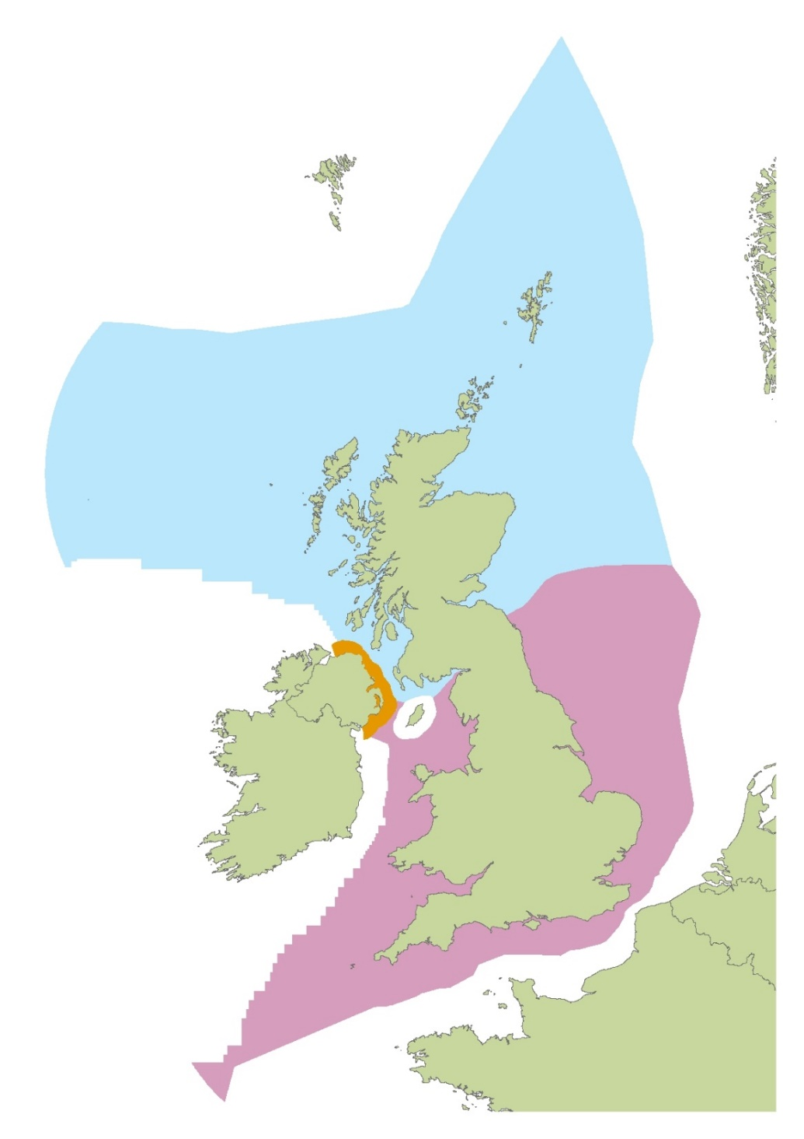
MARINE ENFORCEMENT OFFICER (MEO) POWERS (FISHERIES)
The jurisdiction that MEO’s have in relation to fisheries depends on the nationality of the vessel and its location at the time of inspection.
Vessel in Scottish or N. Irish waters:
MEO powers for English or Welsh vessel;
BSFO powers for any other vessel
Vessel outside EEZ:
MEO powers for English or Welsh vessel;
BSFO powers for any other UK vessel
Any vessel in English or Welsh waters:
MEO powers
Note: Officers use their home powers against home vessels when pursuing them into other administrations’ waters

Slide 7
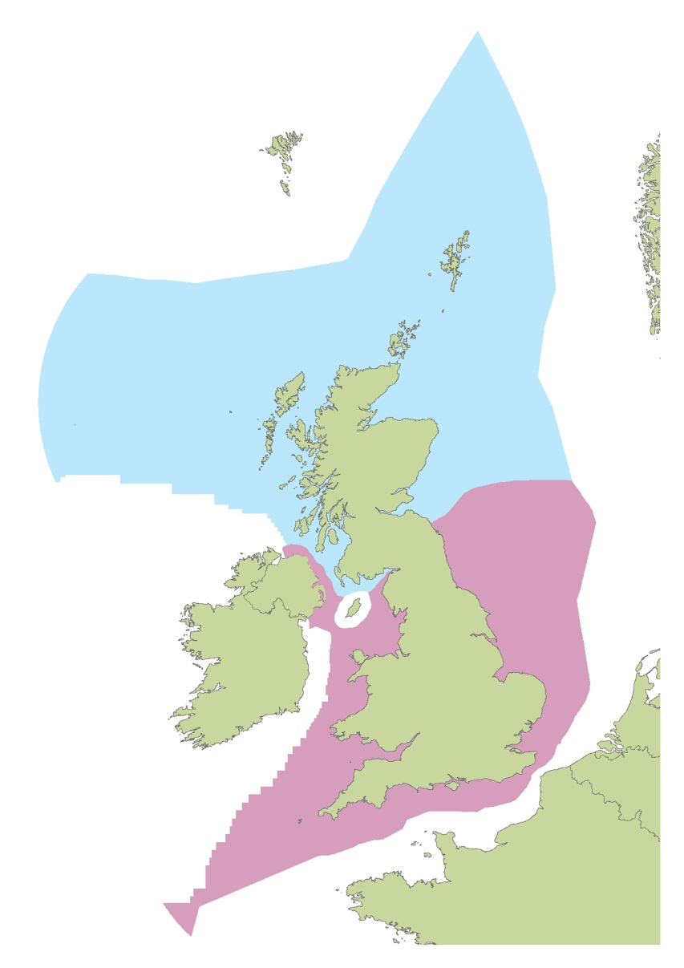
MARINE ENFORCEMENT OFFICER (MEO) POWERS (MARINE LICENSING)
The jurisdiction that MEO’s have in relation to marine licensing is a lot more simple than fisheries as can be seen below.
Scottish enforcement officers will enforce.
Officers appointed by Department for the Environment Northern Ireland, and MEOs appointed by Welsh Ministers / MMO will enforce.

Slide 8
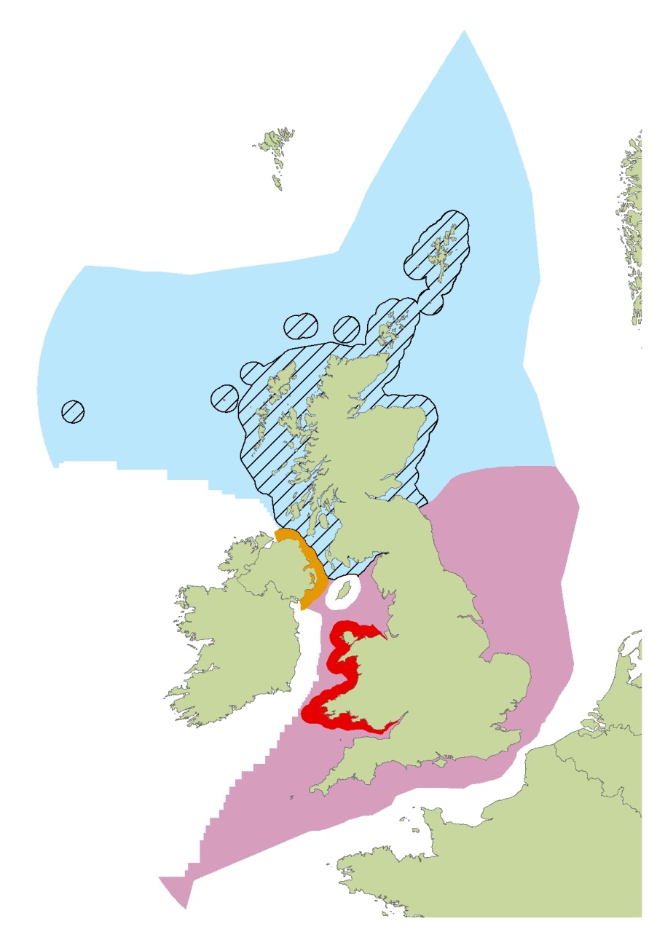
MARINE ENFORCEMENT OFFICER (MEO) POWERS (NATURE CONSERVATION)
Scottish enforcement officers will enforce Scottish nature conservation legislation under existing arrangements or under the Scottish Marine Act.
Scottish officers will enforce Marine Protected Areas. Secretary of State appointed wildlife officers will enforce other nature conservation legislation under the Offshore Marine Regulations.
Northern Irish enforcement officers will enforce under Northern Irish nature conservation legislation.
Welsh Ministers will designate Marine Conservation Zones which MEO’s will enforce.
MMO appointed MEO’s will enforce nature conservation legislation. IFCA’s will also enforce in 0-6nm limit in England.

Slide 9
INSHORE FISHERIES AND CONSERVATION OFFICER (IFCO) POWERS
Who is an IFCO?
IFCO powers are granted under Sections 165 and 166 of the Marine and Coastal Access Act 2009 stating:
(1) An IFC officer appointed for an IFC district has the powers referred to in subsection (3) for the purposes of enforcing—
  (a) any byelaws made under section 155 for the district (or having effect as if so made);
  (b) sections 1 to 3, 5 and 6 of the Sea Fish (Conservation) Act 1967 (c. 84) and any orders made under any of those sections;
  (c) any provision made by or under an order under section 1 of the Sea Fisheries (Shellfish) Act 1967 (c. 83) conferring a right of regulating a fishery;
  (d) any provision of, or any rights conferred by, section 7 of that Act;
  (e) any byelaws made under section 129, 129A, 129B or 132 of this Act;
  (f) section 140 of this Act.
(2) The Secretary of State may by order amend subsection (1).
(3) The powers are—
  (a) the common enforcement powers conferred by this Act;
  (b) the powers conferred by sections 264, 268, 269 and 284.

Slide 10
YOU HAVE NOW COMPLETED THIS MODULE
YOU CAN READ THIS MATERIAL AS MANY TIMES AS YOU LIKE.
TO CHECK YOUR KNOWLEDGE, PLEASE ATTEMPT THE SHORT QUIZ.

